Slide 1
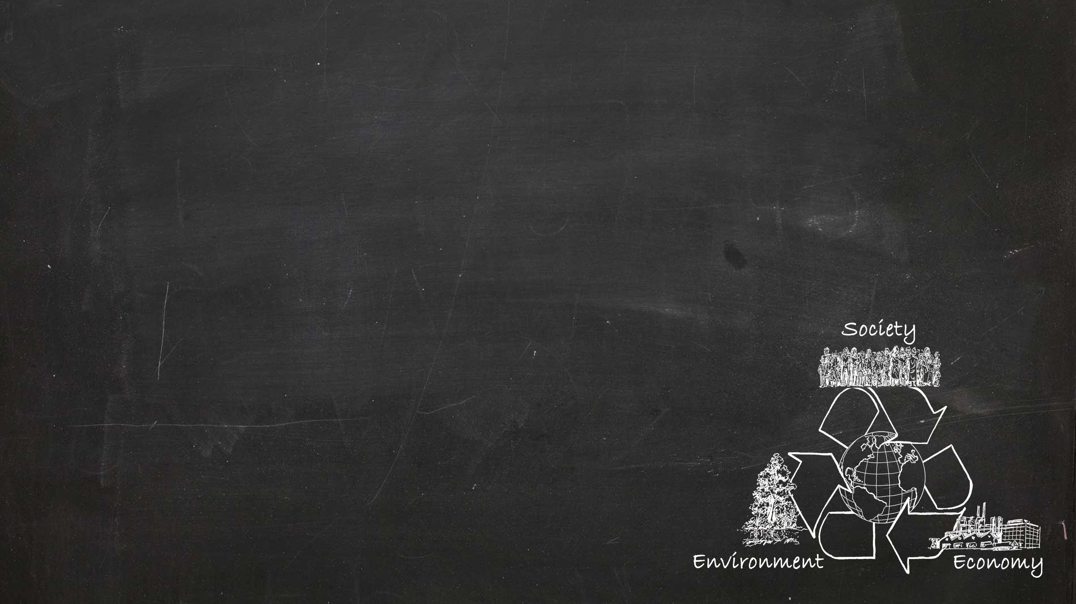
Integrating Sustainable Development into higher education
IN-DEPTH MODULE 4
Teaching material
Sustainable Development
Sustainable Development (SD), globalization, global change
The role of science in SD
Educational content – thematic links between different subjects/disciplines to SD
Values and scientific understanding
These slides may be used according to your teaching needs – please feel free to adapt or complement them.
Notes:
This presentation was translated by Tina Hirschbuehl, CDE.
If not stated otherwise, the sources of the slides and notes are:
Herweg K, Zimmermann AB, Lundsgaard Hansen L, Tribelhorn T, Hammer T, Tanner RP, Trechsel L, Bieri S, Kläy A. 2017. Integrating Sustainable Development into Higher Education — Guidelines with In-depth Modules for the University of Bern. Foundations. Bern: University of Bern, Vice-Rectorate Quality, Vice-Rectorate Teaching, Centre for Development and Environment (CDE), Educational Development Unit (ZUW), and Bern Open Publishing (BOP). DOI: 10.7892/boris.105009
Herweg K, Zimmermann AB, Lundsgaard Hansen L, Tribelhorn T, Rufer L, Hammer T, Tanner RP, Trechsel L, Bieri S, Kläy A. 2016.
Nachhaltige Entwicklung in die Hochschullehre integrieren — Ein Leitfaden mit Vertiefungen für die Universität Bern. Vertiefung 1: Konzepte, Instrumente, Anleitungen, Hinweise und Beispiele. Bern: Universität Bern, Vizerektorat Qualität, Vizerektorat Lehre, Centre for Development and Environment (CDE), Bereich Hochschuldidaktik & Lehrentwicklung, und Bern Open Publishing (BOP). DOI: 10.7892/boris.82668

Slide 2
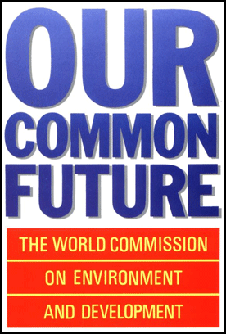
Sustainable Development – Definition
Sustainable Development is “development that meets the needs of the present without compromising the ability of future generations to meet their own needs.”
Definition of the World Commission on Environment and Development (WCED) 1987
Report Our Common Future («Brundtland Report»)
Notes:
Since publication of the Brundtland Report in 1987, the term “Sustainable Development” (SD) has been used as a general guide for global social development. The report, Our Common Future, defines SD as “development that meets the needs of the present without compromising the ability of future generations to meet their own needs.” This understanding of SD was adopted in 1992 by the United Nations Conference on Environment and Development (UNCED – also known as Rio Conference or Earth Summit), and later by numerous organizations and governments – and has since become the most widely used global reference. Like many other countries, Switzerland also represents this understanding both internally and externally. In addition to the environmental, sociocultural, and economic aspects of SD, the UN understanding also includes a spatial and a temporal sustainability dimension.

Slide 3
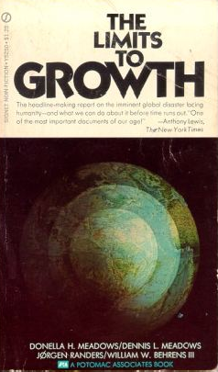
Sustainable Development – Background
«If the present growth trends in world population, industrialization, pollution, food production, and resource depletion continue unchanged, the limits to (physical) growth on this planet will be reached sometime within the next one hundred years. The most probable result will be a rather sudden and uncontrollable decline in both population and industrial capacity.» (Meadows et al. 1972)
Meadows et al. 1972: The Limits to Growth
Notes:
The Limits to Growth is a study commissioned by the Club of Rome and presented in 1972. It examined five global trends: industrialization, population growth, malnutrition, exploitation of raw material reserves, and destruction of habitat. The quote presented in the slide is what the study concluded. In the ensuing years, the results of the study were widely criticized, e.g. that it did not take into account technical progress.
An update to the study in 1992 had better data, took into account the newest developments, and improved their simulations: still, the basic predictions remained the same. Also, the 30-year update to the study in 2004 predicted that limits to growth would be exceeded – resulting in global collapse – by 2100 at the latest, or from as early as 2030 without energy-related countermeasures.
The latest report for the Club of Rome (Jørgen Randers 2012: 2052 – A global forecast for the next 40 years) contains “well-founded assumptions” about future development: it is a renewed attempt to spur society to act.

Slide 4
Sustainable Development – Background
A look back on key debates
1970s and 1980s
Developing countries: international debates on development crises (e.g. debt crisis)
Industrialized countries: international debates on (global) environmental problems
1990s
Euphoria/optimism after end of Cold War
Start of a broad perception of global crises as well as Earth as one system ⇒ development of a (new) «global» consciousness
A new world vision emerges: Environment and Development problems are interlinked (Environment and Development): Development debate and Environment debate are united

Slide 5
Sustainable Development
Today’s broadened understanding based on the UN understanding
Sustainable Development is a long-term, optimistic model of a societal development that centres around people and their needs, skills, and actions.
The goal is inter- and intragenerational socio-cultural and economic justice while at the same time respecting the environmental limits of natural resource use.
This task requires contributions at all levels of decision-making – from the individual to the local, regional, national, international, and global levels.
Correspondingly, voice/participation is a core principle of this model. All actors should coordinate their concrete objectives in their professional and private fields of action according to an overarching vision.
In this sense, SD is a continuous process of negotiation of so-called trade-offs (compromises) to balance diverse environmental, sociocultural, and economic interests, and to settle conflicts of objectives in a consensual and peaceful manner.
The prerequisite for the negotiation is for all actors to be in possession of the necessary knowledge and the ability to act, or at least be enabled to act, accordingly. In addition to suitable institutional framework conditions, research and education are key.

Slide 6
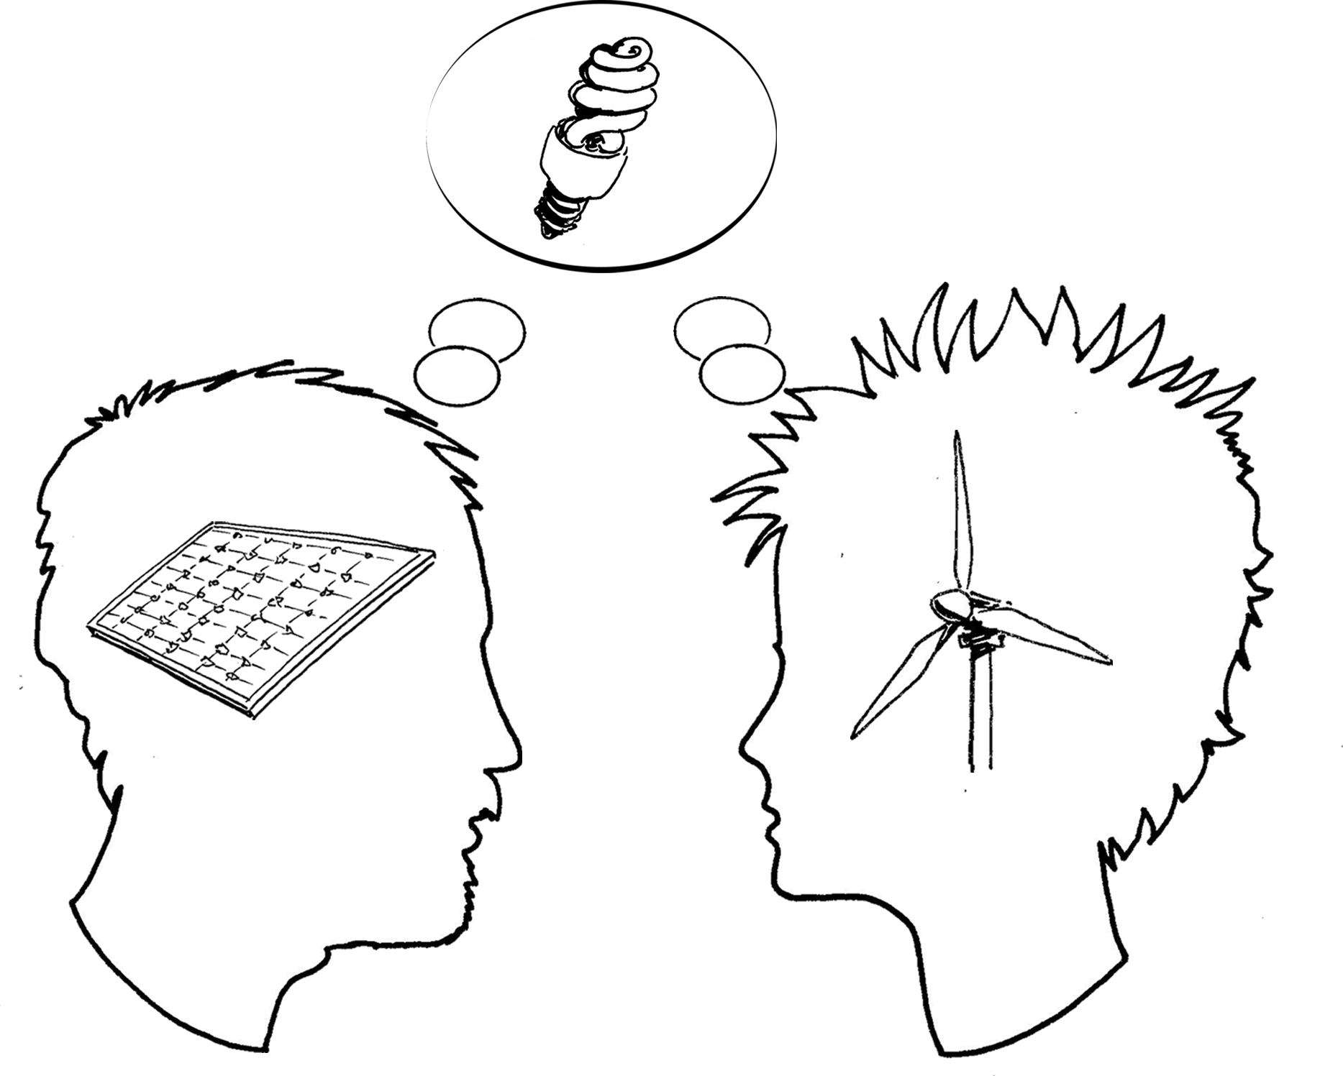
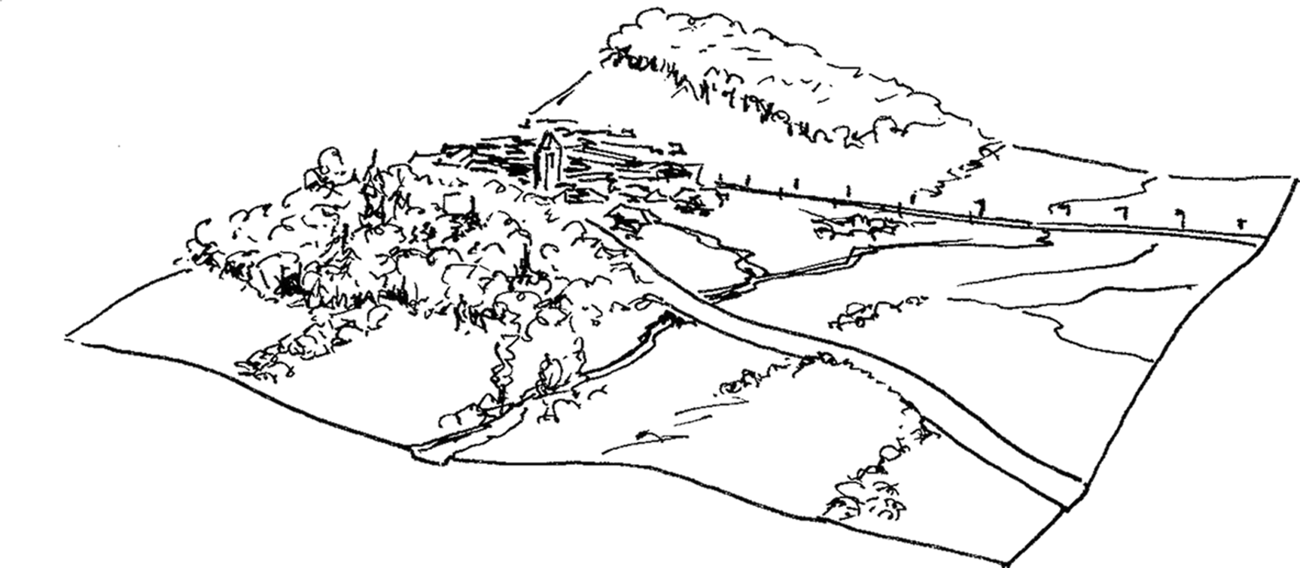
Sustainable Development
Today’s broadened understanding,
based on the UN understanding
At the core of SD lies a global, societal, democratic search, learning, and shaping process.
Search: Negotiating, concretizing, further developing visions and goals of SD
Learning: Continuous acquisition of and reflection on knowledge, skills, and competences, as well as gathering and assessing experiences
Shaping: Transformation, i.e. working out concepts and strategies, as well as implementing measures to promote SD in all fields of action
In a process like this there is not only one Sustainable Development, but a number of possible paths towards SD. These must be continuously assessed, negotiated, and adjusted to achieve the desired impact.

Slide 7
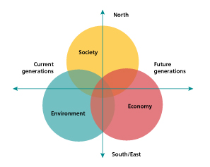
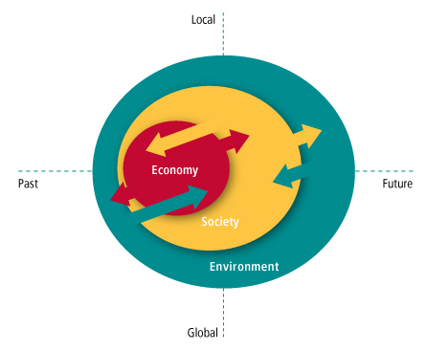
Sustainable Development
Different weighting of the dimensions
Efforts towards a transparent negotiation of trade-offs means that the sustainability dimensions are not always given equal weighting.
MONET system of indicators
(IDANE 2012: BFS, BAFU, ARE, DEZA)
Fachkonferenz Umweltbildung 2010, position paper (adapted)
Notes:
Three dimensions of Sustainable Development (SD): the UN understanding, as it is used in Switzerland for the «Monitoring of Sustainable Development (MONET)» (left), and the adaptation in the position paper of the «Fachkonferenz Umweltbildung» (2010, right). Efforts towards a transparent negotiation of trade-offs means that the sustainability dimensions are not always given equal weighting. SD models with three dimensions are easy to understand and therefore widespread. In a university environment, however, they could give the impression of having neglected aspects such as culture, technology, health, etc. It is therefore important that these not-mentioned but implicit components be made explicit in further work with the models.

Slide 8
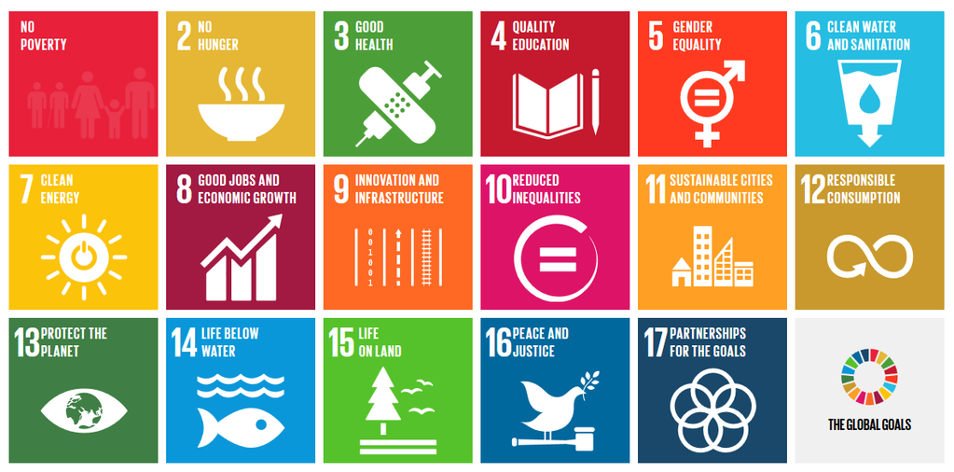
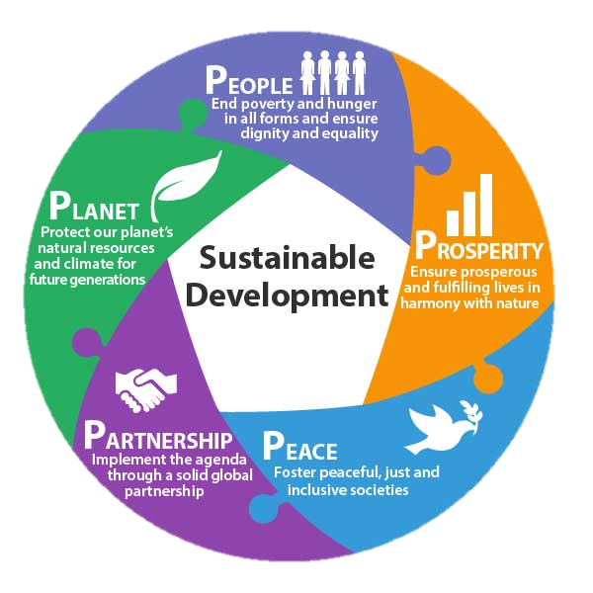
The UN Sustainable Development Goals
17 goals and 169 concrete targets
The UN Sustainable Development Goals or SDGs were approved on 25.9.2015 as the «2030 Agenda for Sustainable Development» by the 193 member states of the UN. They thus have broad global support and form the political basis for efforts towards SD in the coming years.
Notes:
The UN Sustainable Development Goals
In 2000, the UN, World Bank, International Monetary Fund (IMF), and Organization for Economic Cooperation and Development (OECD) formulated eight Millennium Development Goals (MDGs). Both the goals and the way they were set were controversial. The selection was criticized as being incomplete, defined by industrialized countries, lacking binding commitments and coordination of the individual targets, and characterized by unrealistic indicators and target sizes.
Based on this criticism as well as on the intention to unite global environmental policy and poverty reduction in a single initiative, the UN Sustainable Development Goals (SDGs) were formulated – and approved on 25 September 2015 as the «2030 Agenda for Sustainable Development», by the 193 member states of the UN. The SDGs are broad-based and form the global political basis for SD efforts in the coming years.

Slide 9
The UN Sustainable Development Goals
approved on 25.9.2015 by the 193 UN member states
17 goals and 169 concrete targets
No Poverty - End poverty in all its forms everywhere
Zero Hunger - End hunger, achieve food security and improved nutrition and promote sustainable agriculture
Good Health and Well-being - Ensure healthy lives and promote well-being for all at all ages
Quality Education - Ensure inclusive and equitable quality education and promote lifelong learning opportunities for all
Gender Equality - Achieve gender equality and empower all women and girls
Clean Water and Sanitation - Ensure availability and sustainable management of water and sanitation for all
Affordable and Clean Energy - Ensure access to affordable, reliable, sustainable and modern energy for all
Decent Work and Economic Growth - Promote sustained, inclusive and sustainable economic growth, full and productive employment and decent work for all
Industry, Innovation and Infrastructure - Build resilient infrastructure, promote inclusive and sustainable industrialization and foster innovation
Reduced Inequalities - Reduce income inequality within and among countries
Sustainable Cities and Communities - Make cities and human settlements inclusive, safe, resilient and sustainable
Responsible Consumption and Production - Ensure sustainable consumption and production patterns
Climate Action - Take urgent action to combat climate change and its impacts by regulating emissions and promoting developments in renewable energy
Life Below Water - Conserve and sustainably use the oceans, seas and marine resources for sustainable development
Life on Land - Protect, restore and promote sustainable use of terrestrial ecosystems, sustainably manage forests, combat desertification, and halt and reverse land degradation and halt biodiversity loss
Peace, Justice and Strong Institutions - Promote peaceful and inclusive societies for sustainable development, provide access to justice for all and build effective, accountable and inclusive institutions at all levels
Partnerships for the Goals - Strengthen the means of implementation and revitalize the global partnership for sustainable development
http://www.un.org/sustainabledevelopment/sustainable-development-goals/

Slide 10
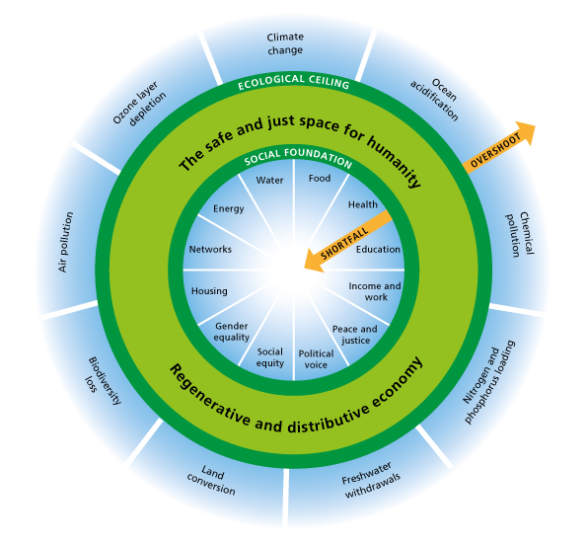
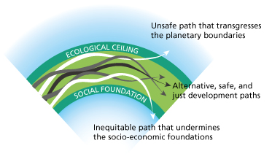
Sustainable Development
Global Debates – the «Doughnut Model»
Different paths of Sustainable Development are possible, as long as they are confined between planetary boundaries and social foundations as «guard rails». These guard rails must be negotiated.
Source: 9 dimensions of planetary boundaries according to Rockström et al. 2009, 12 dimensions of social boundaries according to Raworth 2017, based on government priorities at Rio+20 and later UN Conferences.
Notes:
The Doughnut Model
The Doughnut Model (originally Raworth/Oxfam 2012, updated in Raworth 2017) is an attempt to concretize the general dimensions of Sustainability and thus to operationalize SD. To this end, Raworth first links the concept of SD to the international scientific and political debate on planetary limits on the use and degradation of natural resources (Rockström et al. 2009). In her model, Raworth expands the debate to include minimum thresholds of social and economic foundations that must not be exceeded, to allow all people on the Eartch to live a worthwhile life.
The area of Sustainable Development that is environmentally safe, socially just, and economically viable for humanity is symbolized by the light green area. There is no precise “prescription” as to how SD should look. The model is based on an understanding of SD as a search, learning, and shaping process involving all of society and thus requiring the participation of every individual. The model does not pre-empt this negotiation process, but indicates possible paths towards SD within the light green corridor. This area is enclosed by two “guard rails”, which depict threats to SD. The outer rail shows the “planetary boundaries”, whose natural resources (water, air, land, biodiversity etc.) are being massively degraded by human use. The inside rail comprises the “social foundation”, i.e. the minimum requirements without which human well-being is not possible.
The limits of environmental degradation and the minimum socio-economic requirements are not universally defined and the indicators for measuring current values and trends are the topic of ongoing research and negotiations between various actors with different interests and levels of influence. The political decisions on steering future developments are based on information including prominent scientific contributions to the collection of environmental, sociocultural, and economic systems and their dynamics.

Slide 11
Sustainable Development
Related debates
Globalization: e.g. discussions on sustainable and non-sustainable effects of globalization
Global change: e.g. discussions on the causes and drivers of global change, as well as ways of steering global change through sustainable development.
Sustainable Development: e.g. discussions on limiting risks and making use of opportunities that emerge from globalization and global change.

Slide 12
Globalization
The term «globalization» is used in particular in the social, economic, human, and cultural sciences in the analysis of transnational processes of increasing…
… spread of technologies, innovations, regulations, etc.,
… interdependence in business, society, culture, and politics,
… mobility of goods, services, and people.
In this view, globalization occurs in a spatial distribution and network of relationships, and in the acceleration of various trends and processes in different social dimensions, which transcend national regulations (trans-nationalization) and can be observed in several regions or worldwide.
Dimensions of trends/processes: technological dimension, economic dimension, social dimension, cultural dimension, environmental dimension, political dimension, spatial dimension, etc.
⇒ A key characteristic: the various trends/processes in the different dimensions interact and only constitute globalization through these interactions.

Slide 13
Global change
The term «global change» is used, in particular, in the environmental and natural sciences in the analysis of global environmental changes (e.g. climate change, decrease in biodiversity, desertification/soil degradation, ocean pollution, fresh water scarcity) and major drivers of environmental change (e.g. population growth, urbanization, use of fossil fuels).
From this point of view, global change consists mainly of global environmental changes and the major drivers of change. Global change is often also seen as the result of globalization processes.
In the study of global change, a system-dynamic view of the individual changes as well as the interaction of different change processes with global change drivers is often adopted.

Slide 14
Indicators of non-sustainable development
Ecological Footprint & Human Development Index
The Ecological Footprint und the Human Development Index are indicators for the sustainability of global development:
The Ecological Footprint is the area in hectares per person/year needed to sustainably continue current lifestyles and living standards. It also includes the area needed for the production of food, clothing, energy, waste disposal, and carbon sequestration (Global Footprint Network).
The Human Development Index is a national welfare indicator, which takes into account gross national income (GNI), life expectancy, and expected years of schooling per head (UNDP Human Development Report).

Slide 15
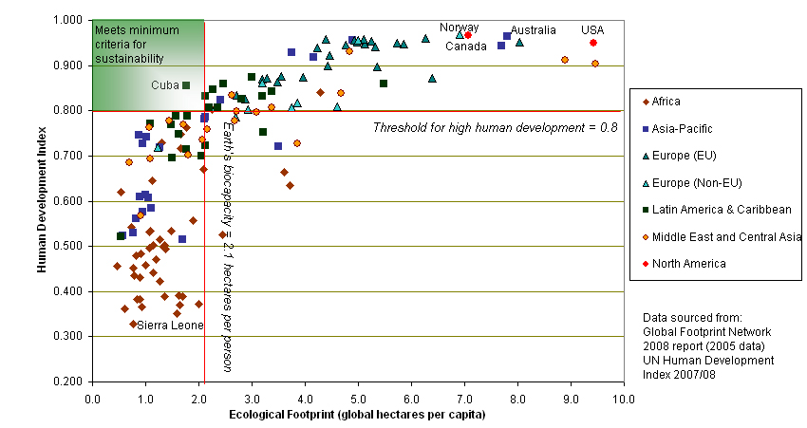
Indicators of non-sustainable development
Ecological Footprint & Human Development Index
A significant reduction in global energy and resource use can only be achieved in industrialized countries. This reduction is imperative to maintain the ecosystem functions for humanity for the generations to come.
Switzerland
In developing countries there is an urgent need to improve the socio-economic conditions of life. Global and social disparities are often the cause of violent conflicts and migration, for example.
Notes:
Despite numerous efforts in the past decades, current global development is far from sustainable. Global environmental problems through overuse of natural resources, social injustices, and poverty persist or are even increasing. This means that efforts to date have not been sufficient. Aggregated indicators such as the “ecological footprint” (Wackernagel und Beyers 2010) show that a significant global decline in energy and resource consumption can only be achieved if the world’s largest consumers, the industrialized countries, limit their consumption. This is vital if ecosystem functions are to be available to humans over future generations. In parallel, the Human Development Index (UNDP 2015) shows that the greatest deficits in socio-economic development still occur in the countries of the global South. Here, too, there is an urgent need for action.

Slide 16
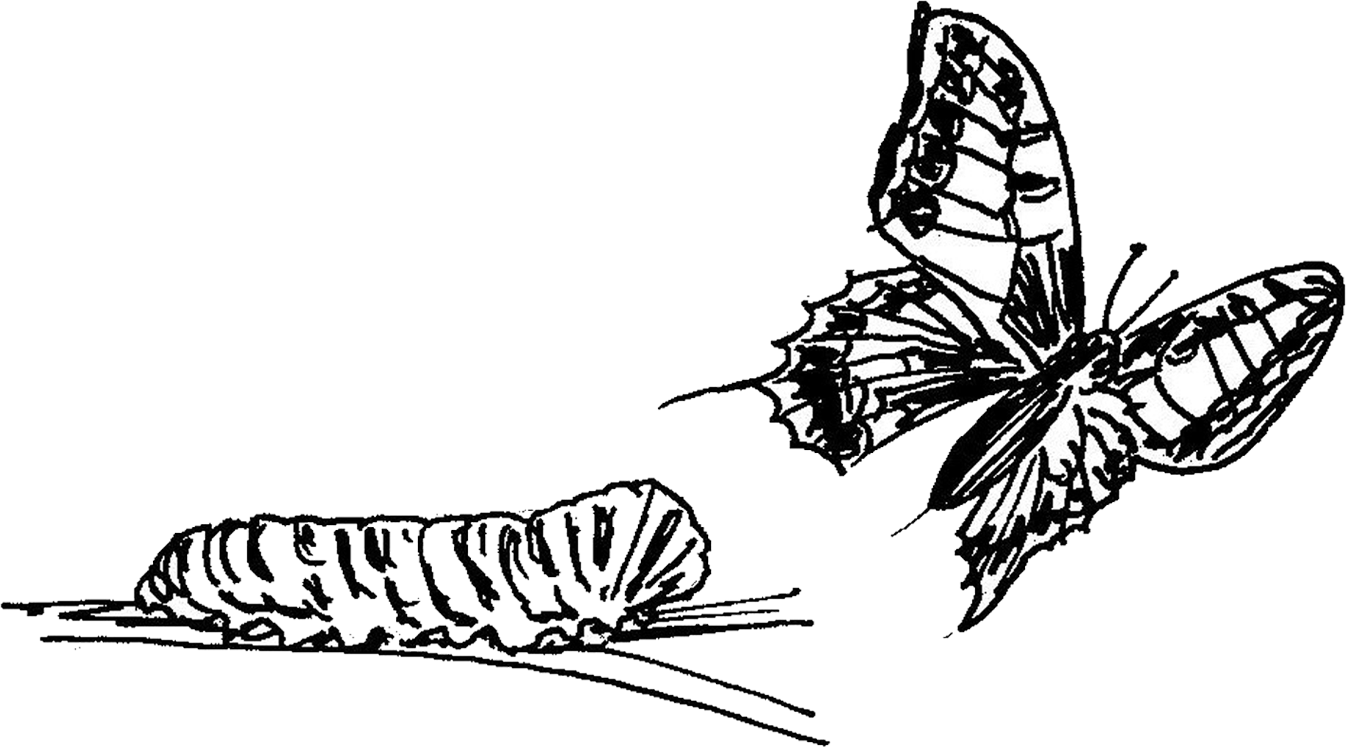
Transformation
So far, we have not succeeded in overcoming the global problems we face. This means that a “business as usual” approach as well as limiting ourselves to minor adaptations or slight behavioural changes will not lead to SD.
This is why the scientific advisory board of the German Advisory Council on Global Change (WBGU), for example, is proposing a “social contract” for a “great transformation” to tackle global megatrends such as climate change, our inability to reduce poverty, increasing drinking water scarcity, etc.
The WBGU postulates an urgent need for…
… a leap in technology,
… new welfare concepts,
… multifaceted social and institutional innovations,
…. and an unprecedented level of international cooperation.

Slide 17
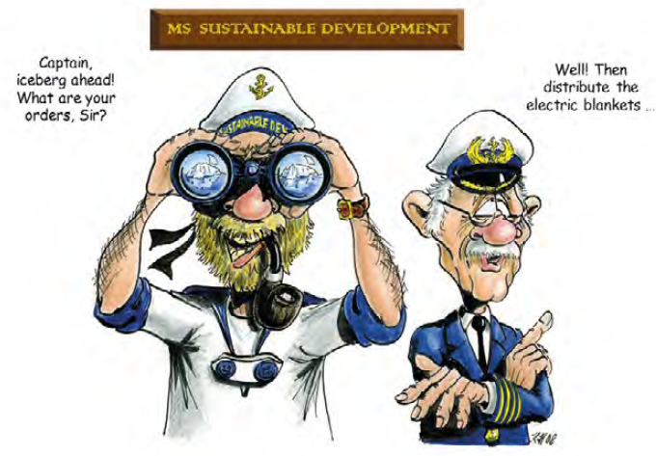
Sustainable Development
What role can science play?
Often, research results indicate massive global problems up ahead. What do we as scientists do with these findings? Do we leave it entirely to policymakers and other actors to interpret our findings and work out solutions? Or do we take on more responsibility ourselves?

Slide 18
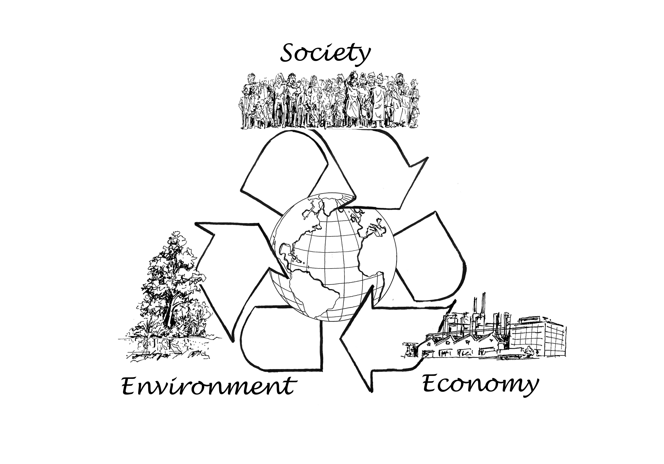
Research for Sustainable Development
An opportunity for science
Social
injustice
and conflicts
Inter- und intragenerational justice
Respect for environmental boundaries
Environmental growth and poverty
Climate change and biodiversity losses
Business that is environmentally and socially compatible
Overall, complex phenomena can only be explained through a multitude of biophysical, socio-cultural, and economic processes which influence each other and whose interlinkages and dynamics are intensified by increasing globalization.

Slide 19
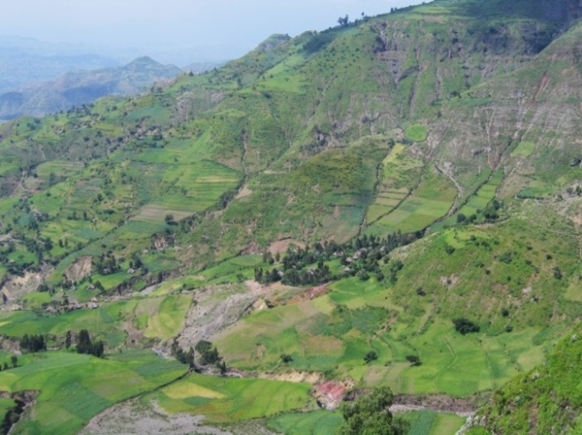
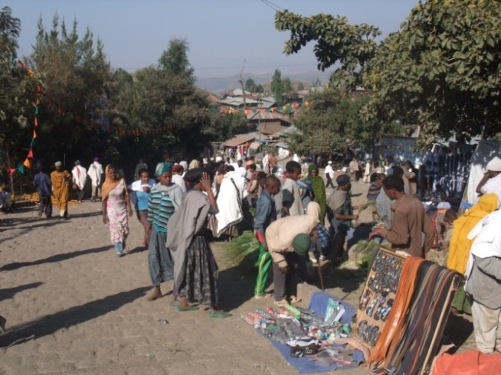
Research for Sustainable Development
Complex Society–Environment interrelations
Sustainable Development requires dealing with complex Society–Environment interrelations (social–ecological systems), which we try to understand while they continuously change with an unprecedented dynamic.
Example: Intensive use and degradation of natural resources in the Ethiopian Highlands, which 80% of the population depend on for their livelihoods. Resource protection measures must be simultaneously environmentally sound, economically viable, and socially compatible. Correspondingly, research into such complex Society–Environment interrelations requires interdisciplinary approaches, concepts, and methods.
Notes:
Phenomena such as climate change, loss of biodiversity, poverty, and social injustices can be viewed from different disciplinary perspectives. Overall, however, they can only be explained by a multitude of biophysical, socio-cultural, and economic processes which influence each other and whose interlinkages and dynamics are intensified by increasing globalization.
An example
Intensive land use in the highlands of Ethiopia causes measurable processes of degradation of natural resources such as plants, water, and soils. Degradation processes can in principle be investigated using purely natural science (biophysical) methods. These resources provide the livelihoods for 80% of the population, which only have little room for manoeuvre. Solutions (resource protection measures) must therefore not only be environmentally compatible – but also economically and socially viable. Finding solutions and, later, monitoring their effects, requires an integration of e.g. biophysical and socio-economic methods in one research approach.
Indeed, one-sided solutions or national political steering instruments are unable to control or reverse negative developments. They often lead to new problems such as violent conflict and uncontrolled migration. For example, predominantly economically-oriented structural adjustment programmes of the World Bank in the 1990s (market liberalization, deregulation, etc.) intensified poverty among broad population sectors in many developing countries, as well as social conflicts and environmental degradation.
Without a major rethink, the same or similar approaches will continue being propagated – with only moderate success – while alternative approaches are not considered.

Slide 20
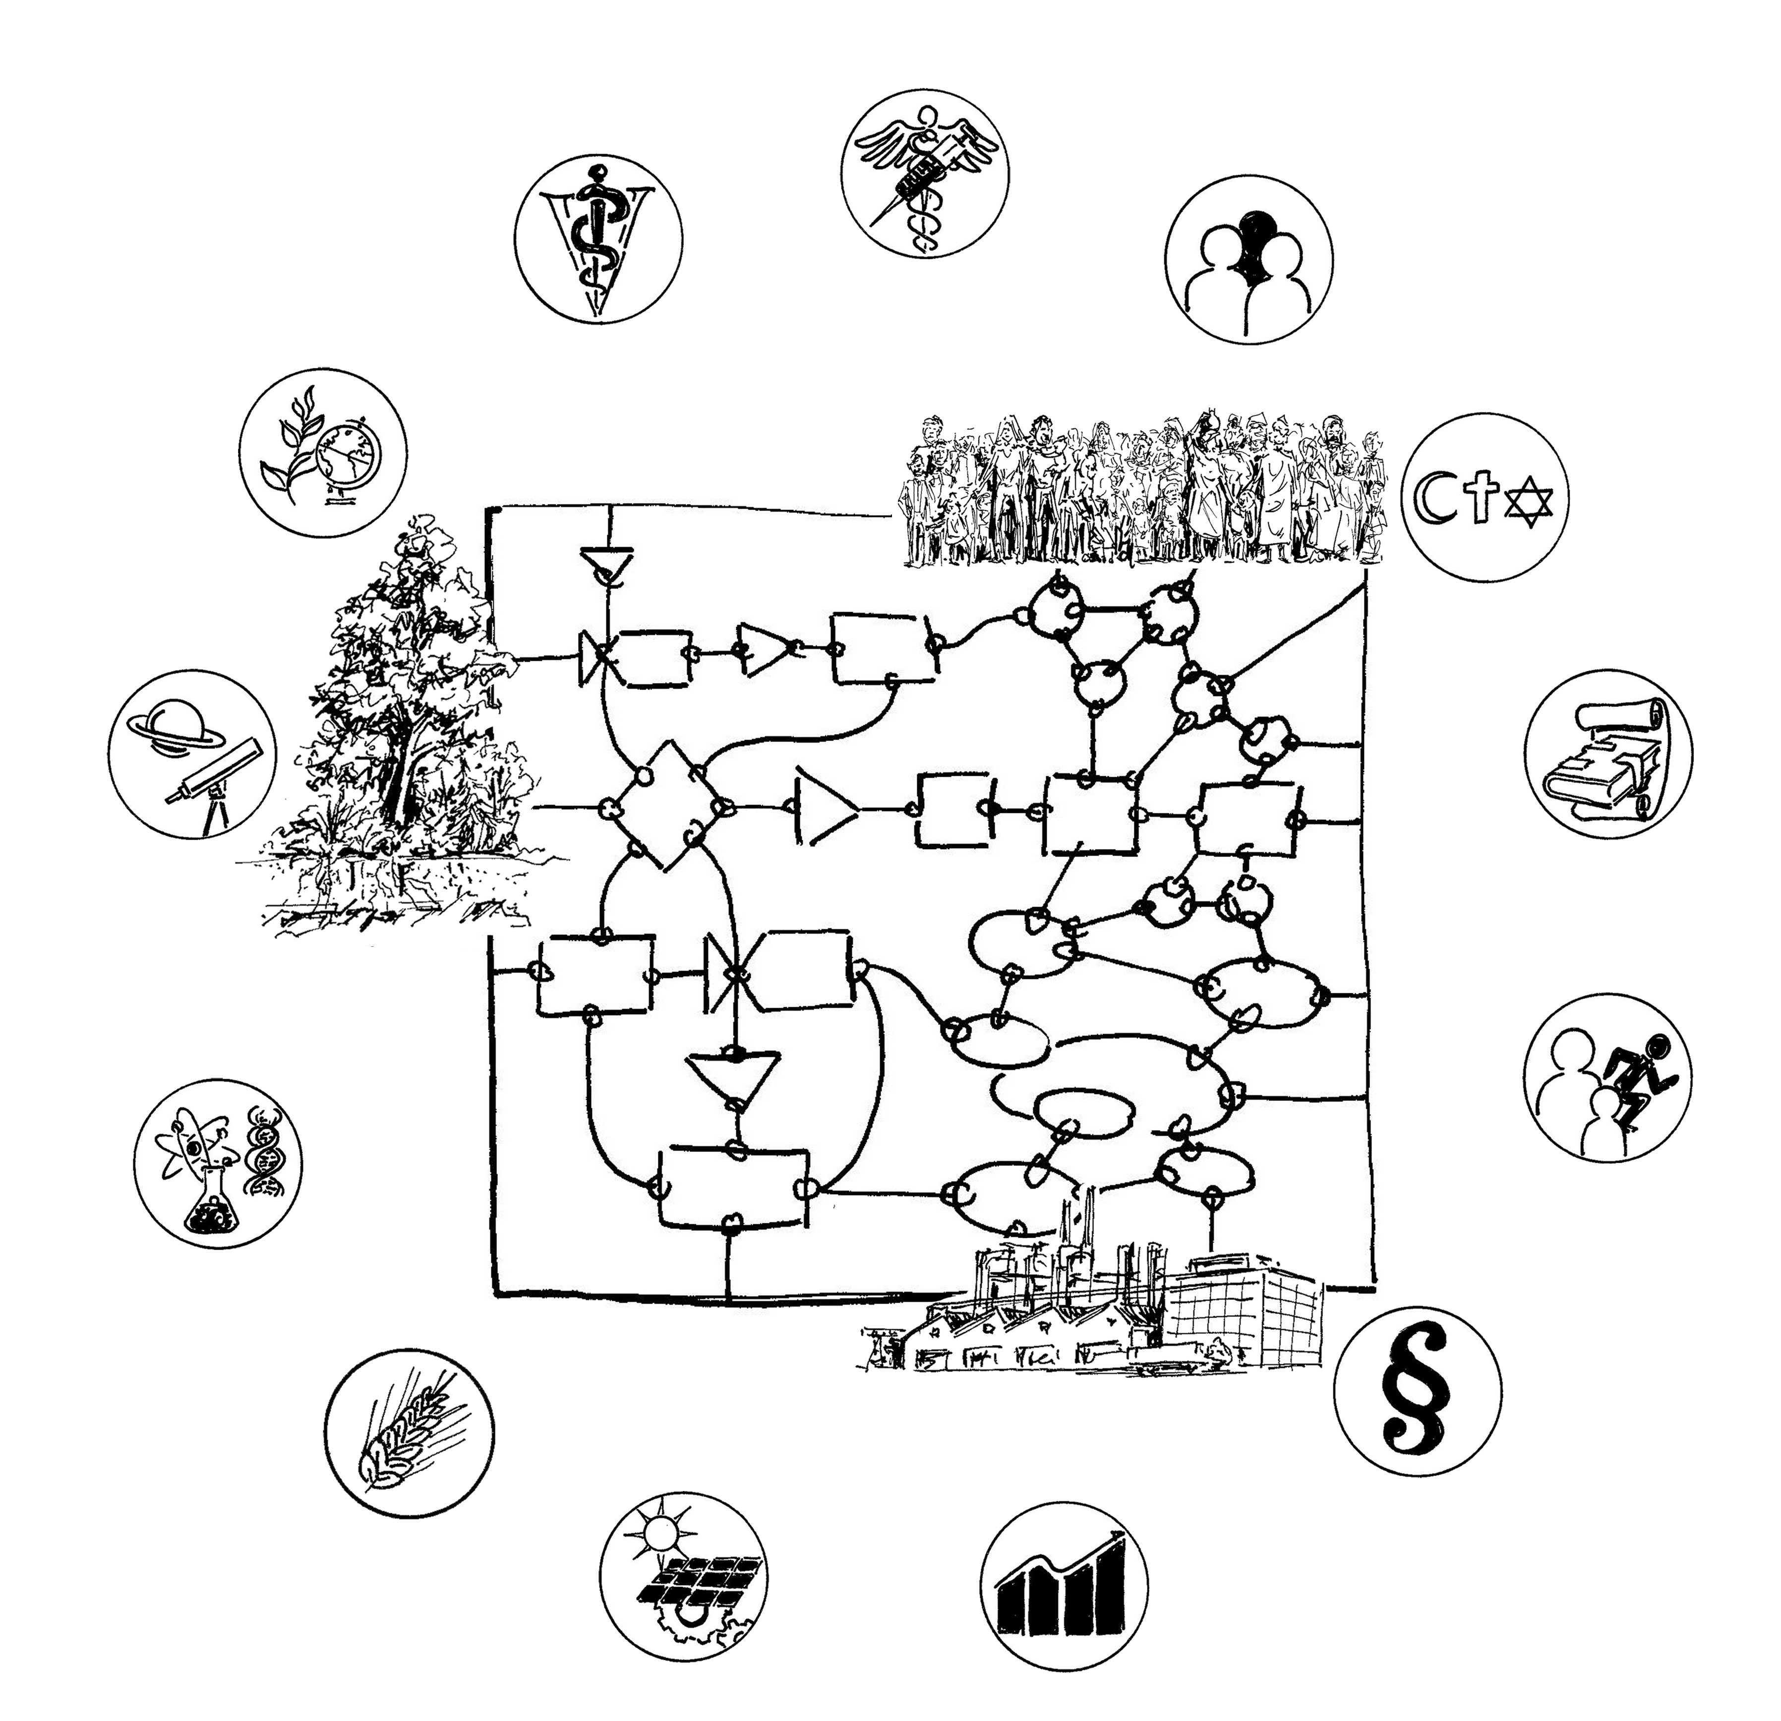
Research for Sustainable Development
Transformative research
To research complex Society–Environment interrelations (social–ecological systems), interdisciplinary cooperation between various scientific disciplines is of fundamental importance.
In addition, SD requires that part of research be action-oriented, using a transdisciplinary approach, i.e. close cooperation between science and society.
The basis of inter- and transdisciplinary cooperation is a well-grounded disciplinary education. For this to be or become relevant to SD, it is important to identify the connections between the disciplines and SD.
Society
Environment
Economy
Notes:
In-depth knowledge is a central basis for decision-making in the negotiation process around SD. Thanks to existing (disciplinary) research and teaching, many foundations have already been laid that contribute to the understanding of the environment, society, and the economy. The various disciplines have developed research approaches, tools, and measures that are of direct or indirect importance to SD, such as methods to record development trends, improve analysis and communication, or enable early detection of problems. These also include models and forecasting scenarios, technologies for use of renewable energies, understanding of motivation and decision-making, and recognizing the importance of cultural diversity and biodiversity. Thus, the disciplines play an important role in highlighting clearly defined problem areas and provide important contributions to solving them. They also stimulate SD-relevant innovations, which are then implemented in industry, society, politics, or culture. But the results of scientific work can be used by different actors for a wide range of purposes – including actions with an unsustainable impact. There is thus also a need for an ethical component.
Each discipline has its specific, historically and culturally evolved importance for society, and thus also for SD. How pronounced or obvious the relation is can vary. A first step towards SD — and an important signal to society — is for the university to clearly state the importance of these diverse implicit references to SD. A key approach for research and teaching for SD is a reflection on one’s own ontological and epistemological foundations, the delimitation from other disciplines, and the potential for interdisciplinary cooperation. This involves asking important questions, e.g. what values are the basis of the respective scientific disciplines, how is a discipline positioned in relation to the normative orientation of SD, and how can it contribute to the pan-societal search, learning, and shaping process. What is the discipline’s position on the value of nature for humans, on justice and human rights, on the postulate of economic growth, on technology development, and on the responsibilities of ethics and science for the future?
Once the disciplinary connections to SD are clarified, further steps can be taken, such as developing inter- und transdisciplinary research in the field of complex social-ecological interrelations. Interdisciplinary cooperation requires efforts in integration. To record, analyse, and assess complex changes and trends requires integrative measurement and data collection concepts, methodologies, and analytical processes. A prerequisite for this is for all participating groups to have a minimal basic understanding of the other scientific traditions, epistemologies, methods, procedures, etc. This is hardly possible without having first reflected on one’s own disciplinary understanding and the relation of one’s discipline to SD. This opens new perspectives for all involved disciplines and strengthens their innovation potential and their respective scientific understanding.

Slide 21
Identifying thematic links
between your own discipline and SD
Exercise
Take the Doughnut Model and/or the UN Sustainable Development Goals to identify links between your discipline and Sustainable Development. The two «models» reflect important international debates or development goals.
Guiding questions:
What thematic areas offer your discipline relevant anchoring points?
What are your topics of research (actual and possible)?
Are there further SD-relevant topics that could be interesting for your discipline but are not contained in either of the two models?
What dimensions of SD (environmental, sociocultural, economic) do your topics take into account?
Which actors and other scientific disciplines would be interesting partners for collaboration?
Is there a relation to practice and if so, what does it consist of?
Notes:
Possible educational contents of SD-relevant courses result from the connection between the thematic and epistemological focuses of a scientific discipline on the one hand, and SD on the other. In some disciplines such links are obvious; in many disciplines the link is implicit but not explicitly mentioned; in others still it still has to be identified.
We propose using SD models and conceptual frameworks pragmatically. Simple models (e.g. with three dimensions of SD) allow an introduction to the subject, but ignore many important aspects or don’t make them explicit. Complex models contain fewer gaps, but are difficult to communicate.
No template will be able to contain all connection possibilities for all disciplines. Existing models and concepts should not immediately be discarded if they do not visibly show the connection between SD and your discipline and its topics. Instead, this lack should be seen as an encouragement to supplement important aspects and perspectives.
This exercise is a way of identifying the links between SD and your discipline – e.g. by students. The models on the following slides can be used for this purpose.

Slide 22
The «Doughnut Model» of Sustainable Development
Exercise – Handout
Source: 9 Dimensions of planetary boundaries according to Rockström et al. 2009, 12 dimensions of social boundaries according to Raworth 2017, based on government priorities at Rio+20 and later UN Conferences.

Slide 23
The UN SDGs
Exercise – handout
End poverty in all its forms everywhere
End hunger, achieve food security and improved nutrition and promote sustainable agriculture
Ensure healthy lives and promote well-being for all at all ages
Ensure inclusive and equitable quality education and promote lifelong learning opportunities for all
Achieve gender equality and empower all women and girls
Ensure availability and sustainable management of water and sanitation for all
Ensure access to affordable, reliable, sustainable and modern energy for all
Promote sustained, inclusive and sustainable economic growth, full and productive employment and decent work for all
Build resilient infrastructure, promote inclusive and sustainable industrialization and foster innovation
Reduce income inequality within and among countries
Make cities and human settlements inclusive, safe, resilient and sustainable
Ensure sustainable consumption and production patterns
Take urgent action to combat climate change and its impacts by regulating emissions and promoting developments in renewable energy
Conserve and sustainably use the oceans, seas and marine resources for sustainable development
Protect, restore and promote sustainable use of terrestrial ecosystems, sustainably manage forests, combat desertification, and halt and reverse land degradation and halt biodiversity loss
Promote peaceful and inclusive societies for sustainable development, provide access to justice for all and build effective, accountable and inclusive institutions at all levels
Strengthen the means of implementation and revitalize the global partnership for sustainable development
http://www.un.org/sustainabledevelopment/sustainable-development-goals/

Slide 24
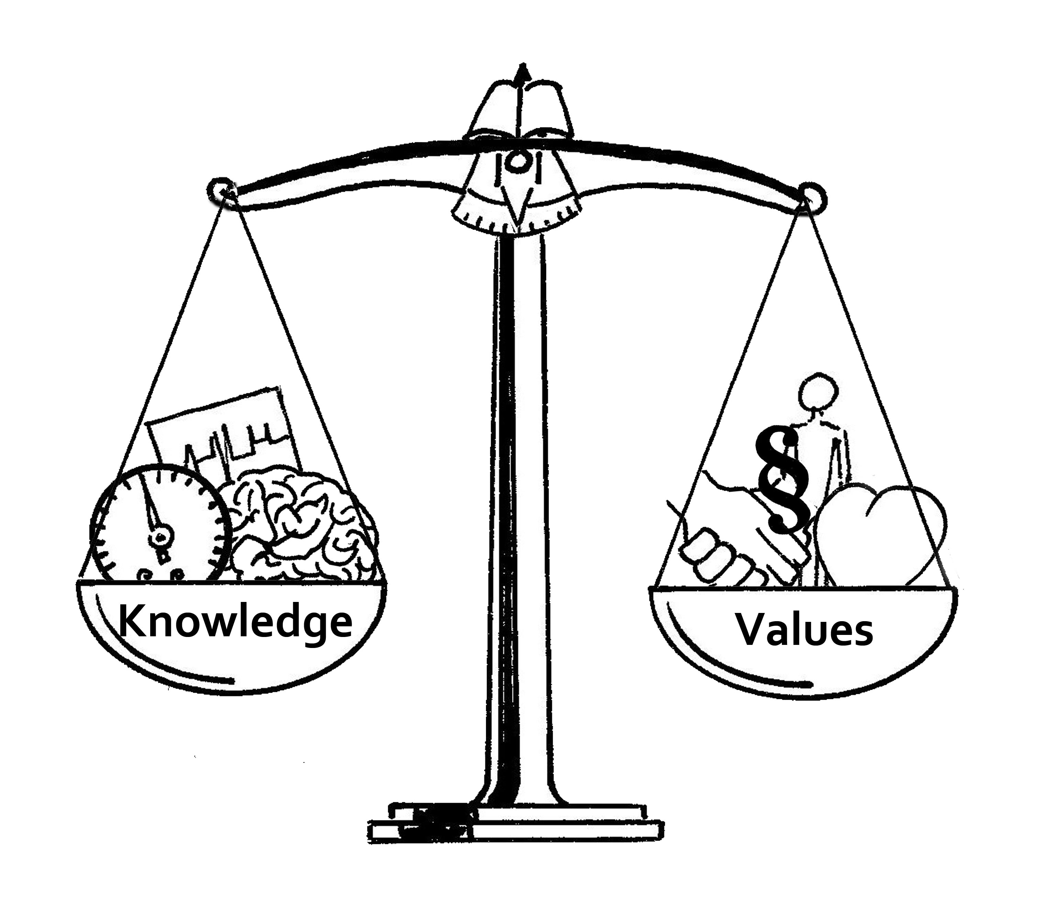
Values and scientific understanding
A challenge for science
A close collaboration between science and society – a transdisciplinary approach – involves the cooperation of a large number of actors with different interests and values, which should be integrated if possible.
Therefore, if science and the university want to play an active role in SD, they should face a discussion on values and bring these in line with their scientific understanding.
Transdisciplinary cooperation gives rise to new forms of knowledge from the contributions of science and other, non-academic actors, and knowledge co-production takes place.
This knowledge can be differentiated in terms of its importance for SD:
Systems knowledge
Target knowledge
Transformation knowledge

Slide 25
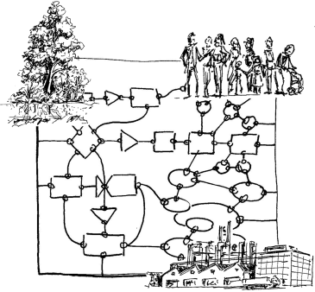
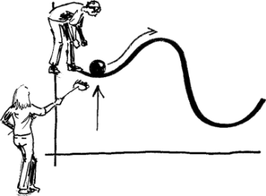
Forms of knowledge relevant to SD
Systems knowledge
Understanding how the environment, economy, and society function
Target knowledge
Basis for decision-making; developing and negotiating goals and visions for a sustainable development
SD
Transformation knowledge
Implementing visions: Technologies, measures, rules, impact monitoring, cultural practices, etc. that support a sustainable development
Based on ProClim/CASS 1997, Pohl & Hirsch Hadorn 2007 Graphics: K Herweg
Notes:
Finding out how and where your discipline is connected with the Doughnut Model or the UN SDGs can help you position it with respect to SD. These are starting points to highlight existing ways in which your discipline refers to SD and identify possible anchoring points. Once the thematic links are made, these can be further concretized by asking which forms of knowledge are important in that particular discipline with respect to SD.
Systems knowledge — Understanding how the environment, society, and economy function – individually, or as complex interactions;
Target knowledge — Scientific contributions to decide the direction in which these relations can be steered towards a sustainable development; and
Transformation knowledge — Scientific contributions to implementation, e.g. in the form of rules, solutions, measures, cultural practices, or technologies to promote sustainable development; this includes monitoring and a review of goal achievement with disciplinary and interdisciplinary scientific methods.
In principle, each discipline can contribute to all three forms of knowledge, albeit to varying degrees. Concretizing the links in this way requires an examination of, or reflection on, the scientific understanding of one’s own discipline. While systems knowledge is the core business of many scientific disciplines, target and transformation knowledge are normative, value-laden categories. To capture as many of their entry points to SD as possible, every discipline should try to identify contributions to all three forms of knowledge. This distinction is heuristic, i.e. it is not the final categorization which is decisive, but the process of reflecting on the relation between scientific work and SD.

Slide 26
Educational content
Examples: Links between scientific disciplines and SD
Systems knowledge
Systems understanding: Environment, Society, Economy Global change, climate, impact of climate change Ecosystems, functions, conditions for plant growth, biodiversity, nutrient and pollutant cycles Variability, vulnerability, resilience of ecological systems Raw materials, deposits, material properties Degradation and sustainable use of renewable resources Contaminated-site clean-up, storage of nuclear waste Use of renewable energies, technologies, biotechnology Mathematical methods, quantitative analysis, statistics, stochastics, developing SD models, data evaluation and processing Political processes, links between political parties and organizations Formal and informal institutions, tools, and processes of political opinion formation Rights and laws related to SD-relevant areas Instruments for political influence Relationship between individual/society – the state and how it is changing in the course of globalization Social ecological systems, human–nature interface ...
These examples are based on the contributions of various authors of the Guidelines: «Integrating Sustainable Development into higher education» and on answers by students to the BScMiSD exam question: «what contributions could your major make to Sustainable Development?».

Slide 27
Educational content
Examples: Links between scientific disciplines and SD
Systems knowledge
Historical understanding of the transformation of traditional societies and their relationship to nature Diverse social and power structures, cultures (values, norms, religion) Different values Ethnic and political causes of resource conflict Forms and sources of social inequality, causes of poverty Language as a heritage of cultural history; sociolinguistic research (e.g. on justice) Use of language and linguistic structures in international negotiations Rhetoric und linguistic logic; discourse analysis to understand power structures Theatre performances (e.g. of debates); different forms of alienation from and communication about SD Understanding, treatment of complex topics Media usage, media reception, dissemination of important information, advertising, behavioural patterns Human action, behaviour, cognition of the environment, society, economy, decision-making Health, prevention, well-being, the role of sports and physical activity Human and animal health Medicinal plants Personality psychology, crime, and violence Ways of functioning of various economic systems, economic paradigms, economic models Econometrics Influence of growth-based economy and global trade on SD and global disparities Post-growth economy Externalities Risk minimization vs profit maximization, money-free societies Corporate structures, entrepreneurial motivations, business models of cost transparency, potential for savings ...
These examples are based on the contributions of various authors of the Guidelines: «Integrating Sustainable Development into higher education» and on answers by students to the BScMiSD exam question: «what contributions could your major make to Sustainable Development?».

Slide 28
Educational content
Examples: Links between scientific disciplines and SD
Target knowledge
Value of nature conservation Quantifiable guidelines and values, mathematical calculation of planetary boundaries, resource efficiency Transfer of principles of the functioning of nature to other sustainability dimensions Political visions, state forms, government systems, legal liabilities – role model, best practices Model «social contracts», sustainability-oriented legislation, and institutions Visions based on knowledge of historically sustainable and non-sustainable developments Alternative processes or goal-setting for Sustainable Development, development scenarios Spatial planning Ethics, values, and justice Description of cultural sustainability, scenarios, and potential worlds Variety of SD understandings, different level of importance of SD in different societies Visions, parameters, and indicators for justice, equality, redistribution Social standards of a globalized society, solidarity societies Promotion of language as a part of cultural identity Reduction of discrimination on the basis of language, visions on equality of all languages and dialects Global access to open data for all population strata Educational goals, goals for psychological health and satisfaction of needs Supra-individual parameters for well-being, context-specific indicators of a «good life» and social welfare Sustainable tourism, recreation, nature experiences, recovery/relaxation, socio-cultural sustainability Models, values, and economic systems that contribute to reducing disparities and inequalities of distribution Alternative business models Sustainable entrepreneurial visions, responsibility of multinational companies, internalization of costs Key figures (economic efficiency, environmental protection, emission rates, social compatibility), stress limits of the ecosystem and society Change in consumption patterns ...
These examples are based on the contributions of various authors of the Guidelines: «Integrating Sustainable Development into higher education» and on answers by students to the BScMiSD exam question: «what contributions could your major make to Sustainable Development?».

Slide 29
Educational content
Examples: Links between scientific disciplines and SD
Transformation knowledge
Scientific monitoring systems Compilation of environmental, social, and economic indicators in the assessment of SD Development of appropriate monitoring methods, standards Development of interpretation and assessment procedures Modelling (climate, energy, consumption, transport, infrastructure, population etc.), simulation models, efficient algorithms, creating scenarios Forecasts on the progress of SD, predictions, dynamic modelling of trends, stability calculations, and modelling of measures against natural catastrophes, etc. Analyses with local-specific SD indicators and indigenous methods Verification of achievement: environmental compatibility, social compatibility, profitability Resource efficiency, sustainable technologies Optimization of plant production, e.g. Development of properties to increase resistance to climate change and environmental changes Resource protection, remediation of contaminated soils through phytoremediation, regeneration of plant communities and animal species, water protection Rocks as energy carriers, availability of non-renewable natural resources SD-relevant technology development, technologies for use of alternative energies, solar, wind, geothermal energy, etc. Low-cost/high-tech solutions, use of environmentally friendly materials Development of participatory processes, consensus/negotiation solutions, coalitions, and majority formation Taxation systems (energy, labour), monetary evaluation of ecosystem services, certifications Historical SD considerations as an educational contribution Mediation of values, ethics; Potential of spirituality for SD Social learning processes, awareness-raising, environmental awareness, value change, incentive systems Migration & Integration (e.g. through sports) Sufficient lifestyles and consumption patterns (reduced resource consumption) ...
These examples are based on the contributions of various authors of the Guidelines: «Integrating Sustainable Development into higher education» and on answers by students to the BScMiSD exam question: «what contributions could your major make to Sustainable Development?».

Slide 30
Educational content
Examples: Links between scientific disciplines and SD
Transformation knowledge
Language education for broad population sectors worldwide, strengthen educational foundations in the global South, from primary school to the publication level of researchers «Agreed language», i.e. agreed-upon terminology as the basis for successful negotiations, understanding, teamwork Communication, negotiation, argumentation, presentation, vocal training, comprehensible transmission of complex connections Theatre and music stages as experimental arenas; promoting the knowledge base, participation and voice in SD Literature and media as transmitters of knowledge and as activation instruments, SD as utopias, fictional literature Poetry as a creative school of thought connecting people Development of new communication channels, use, and valuation of new media Filtering and dissemination of information, knowledge processing, informatics, and communication Improved science communication (in particular, improved access to knowledge in the global South) Communications technology, access to comprehensible information, North-South networks, communications strategies Training in solution-oriented inter- and transdisciplinarity Motivation of individuals and society to commitment to SD, acceptance for the lowering of living standards in industrialized countries Strengthening the One-Health concept (combined human and animal health) in areas with mobile and sedentary populations Migration and integration (e.g. through sports) Alternative economic systems, legal regulations, steering fees, market regulation, incentive systems Environmental, social, and economic innovations with the potential of promoting SD Employment models with fair wages and working conditions, entrepreneurial alternatives, sustainable business processes Adaptive management, change management, personnel management, leadership styles Implementation of prevention/«polluter pays» principles Sustainable event management, sport tourism ...
These examples are based on the contributions of various authors of the Guidelines: «Integrating Sustainable Development into higher education» and on answers by students to the BScMiSD exam question: «what contributions could your major make to Sustainable Development?».

Slide 31
References
Fachkonferenz Umweltbildung. 2010. Positionspapier. Bern: Fachkonferenz Umweltbildung. IDANE [Interdepartementaler Ausschuss Nachhaltige Entwicklung] 2012. Nachhaltige Entwicklung in der Schweiz. Ein Wegweiser. Bern: IDANE. Meadows DL, Meadows DH, Randers J. 1972. The Limits to growth; a report for the Club of Rome's project on the predicament of mankind. New York: Universe Books. Meadows DL, Meadows DH, Randers J. 1992. Beyond the Limits. Post Mills, Vt.: Chelsea Green Publications. Meadows DL, Meadows DH, Randers J. 2005. The Limits to Growth. The 30-Year Update. United Kingdom: Earthscan.. Pohl C, Hirsch Hadorn G. 2007. Principles for Designing Transdisciplinary Research. Translated by AB Zimmermann. Munich, Germany: oekom. Proclim/CASS [Forum for Climate and Global Change/Conference of the Swiss Scientific Academies] 1997. Visions by Swiss Researchers: Research on Sustainability and Global Change – Visions in Science Policy by Swiss Researchers. Bern, Switzerland: ProClim/CASS. http://proclimweb.scnat.ch/portal/ressources/1122.pdf; 27.08.2017. Randers J. 2012. 2052. Der neue Bericht an den Club of Rome. Eine globale Prognose für die nächsten 40 Jahre. München: oekom. Raworth K. 2012. A Safe and Just Space for Humanity. Can We Live Within the Doughnut? Cowley, Oxford: Oxfam. www.oxfam.org/sites/www.oxfam.org/files/file_attachments/dp-a-safe-and-just-space-for-humanity-130212-en_5.pdf; 27.08.2017. Rawoth K. 2017. What on Earth is the Doughnut?… Exploring Doughnut Economics. https://www.kateraworth.com/doughnut/; 27.08.2017. Rockström J, Steffen W, Noone K, Persson A, Chapin FS, Lambin EF, Lenton TM, Scheffer M, Folke C, Schellnhuber HJ et al. 2009. A safe operating space for humanity. Nature 461(7263):472–475. Schweizerische Eidgenossenschaft. 2016. Die 17 Ziele für nachhaltige Entwicklung. [Internet]. Bern. https://www.eda.admin.ch/post2015/de/home/ziele/die-17-ziele-fuer-eine-nachhaltige-entwicklung.html; 20.04.2016. UN [United Nations]. 2016. We Can End Poverty. Millennium Development Goals and Beyond 2015. New York: United Nations. [Internet]. http://www.un.org/millenniumgoals/; 30.04.2015. UN [United Nations] General Assembly. 2015. Transforming Our World: The 2030 Agenda for Sustainable Development. New York: United Nations. https://sustainabledevelopment.un.org/post2015/transformingourworld/publication; 20.04.2016. UNDP [United Nations Development Programme]. 2015. Human Development Index (HDI) [Internet]. New York: UNDP. http://hdr.undp.org/en/content/human-development-index-hdi; 20.04.2016. Wackernagel M, Beyers B. 2010. Der Ecological Footprint. Die Welt neu vermessen. Hamburg: Europäische Verlagsanstalt. WBGU [Wissenschaftlicher Beirat der Bundesregierung Globale Umweltveränderungen]. 2011a. A Social Contract for Sustainability. Factsheet 1. Berlin: WBGU. WBGU [Wissenschaftlicher Beirat der Bundesregierung Globale Umweltveränderungen]. 2011b. World in Transition – A Social Contract for Sustainability. Berlin: WBGU. WCED [World Commission on Environment and Development]. 1987. Our Common Future. [Brundtland Report]. New York: Oxford University Press.

