Slide 1
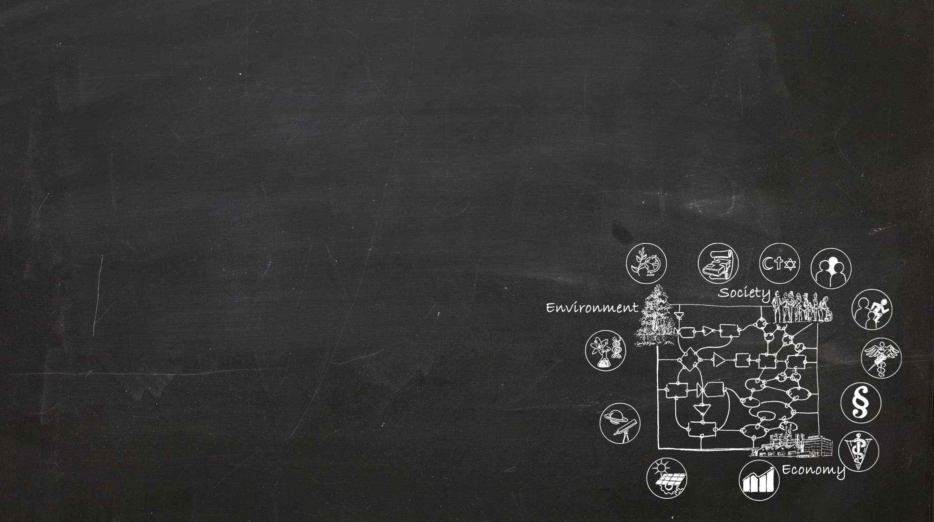
Integrating Sustainable Development into higher education
IN-DEPTH MODULE 4
Teaching material
Education for Sustainable Development
Contributions of a university to Sustainable Development
Educational content
Competences
Teaching-Learning arrangements
These slides may be used according to your teaching needs – please feel free to adapt or complement them.
Notes:
This presentation was translated by Tina Hirschbuehl, CDE.
If not stated otherwise, the sources of the slides and notes are:
Herweg K, Zimmermann AB, Lundsgaard Hansen L, Tribelhorn T, Hammer T, Tanner RP, Trechsel L, Bieri S, Kläy A. 2017. Integrating Sustainable Development into Higher Education — Guidelines with In-depth Modules for the University of Bern. Foundations. Bern: University of Bern, Vice-Rectorate Quality, Vice-Rectorate Teaching, Centre for Development and Environment (CDE), Educational Development Unit (ZUW), and Bern Open Publishing (BOP). DOI: 10.7892/boris.105009
Herweg K, Zimmermann AB, Lundsgaard Hansen L, Tribelhorn T, Rufer L, Hammer T, Tanner RP, Trechsel L, Bieri S, Kläy A. 2016.
Nachhaltige Entwicklung in die Hochschullehre integrieren — Ein Leitfaden mit Vertiefungen für die Universität Bern. Vertiefung 1: Konzepte, Instrumente, Anleitungen, Hinweise und Beispiele. Bern: Universität Bern, Vizerektorat Qualität, Vizerektorat Lehre, Centre for Development and Environment (CDE), Bereich Hochschuldidaktik & Lehrentwicklung, und Bern Open Publishing (BOP). DOI: 10.7892/boris.82668

Slide 2
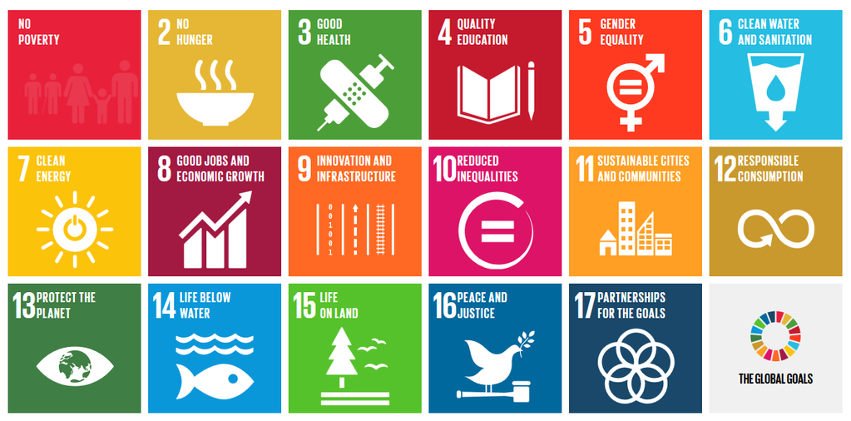
Education for Sustainable Development
«Sustainable Development (NE) is a value-led, open concept, which must find innovative ways and make unconventional decisions; accordingly, simultaneously the processes of a sustainable development are – necessarily – also learning processes» (Stoltenberg and Burandt 2014: 568, own translation).
We can support these learning processes as researchers and lecturers, not by promoting SD as a behavioural code, but by sensitizing students to the importance of science for society and its future.
This is why we are taking part in the societal project “Education for Sustainable Development” (ESD). ESD serves to enable all societal actors to participate in this individual and social search, learning, and shaping process, aiming for alternative pathways – as defined by the United Nations in the
Sustainable Development Goal (SDG) number 4.
Notes:
The United Nations Sustainable Development Goals (SDGs)
http://www.un.org/sustainabledevelopment/education/ (click on Goal 4 targets)
Goal 4: Ensure inclusive and quality education for all and promote lifelong learning
* By 2030, ensure that all girls and boys complete free, equitable and quality primary and secondary education leading to relevant and Goal-4 effective learning outcomes
* By 2030, ensure that all girls and boys have access to quality early childhood development, care and preprimary education so that they are ready for primary education
* By 2030, ensure equal access for all women and men to affordable and quality technical, vocational and tertiary education, including university
* By 2030, substantially increase the number of youth and adults who have relevant skills, including technical and vocational skills, for employment, decent jobs and entrepreneurship
* By 2030, eliminate gender disparities in education and ensure equal access to all levels of education and vocational training for the vulnerable, including persons with disabilities, indigenous peoples and children in vulnerable situations
* By 2030, ensure that all youth and a substantial proportion of adults, both men and women, achieve literacy and numeracy
* By 2030, ensure that all learners acquire the knowledge and skills needed to promote sustainable development, including, among others, through education for sustainable development and sustainable lifestyles, human rights, gender equality, promotion of a culture of peace and non-violence, global citizenship and appreciation of cultural diversity and of culture’s contribution to sustainable development
* Build and upgrade education facilities that are child, disability and gender sensitive and provide safe, nonviolent, inclusive and effective learning environments for all
* By 2020, substantially expand globally the number of scholarships available to developing countries, in particular least developed countries, small island developing States and African countries, for enrolment in higher education, including vocational training and information and communications technology, technical, engineering and scientific programmes, in developed countries and other developing countries
*By 2030, substantially increase the supply of qualified teachers, including through international cooperation for teacher training in developing countries, especially least developed countries and small island developing states

Slide 3
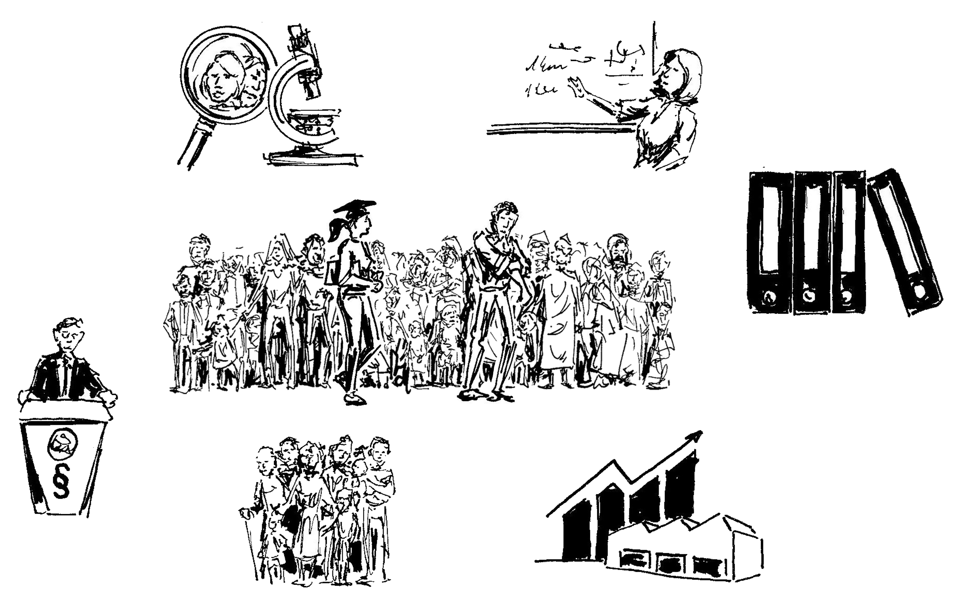
Why university education for Sustainable Development?
How many of your graduates work in research and teaching after their studies?
How many graduates take on other positions of responsibility in the fields of administration, private industry, civil society, politics, etc.?
Research
Teaching
Administration
Politics
Civil society
Economy

Slide 4
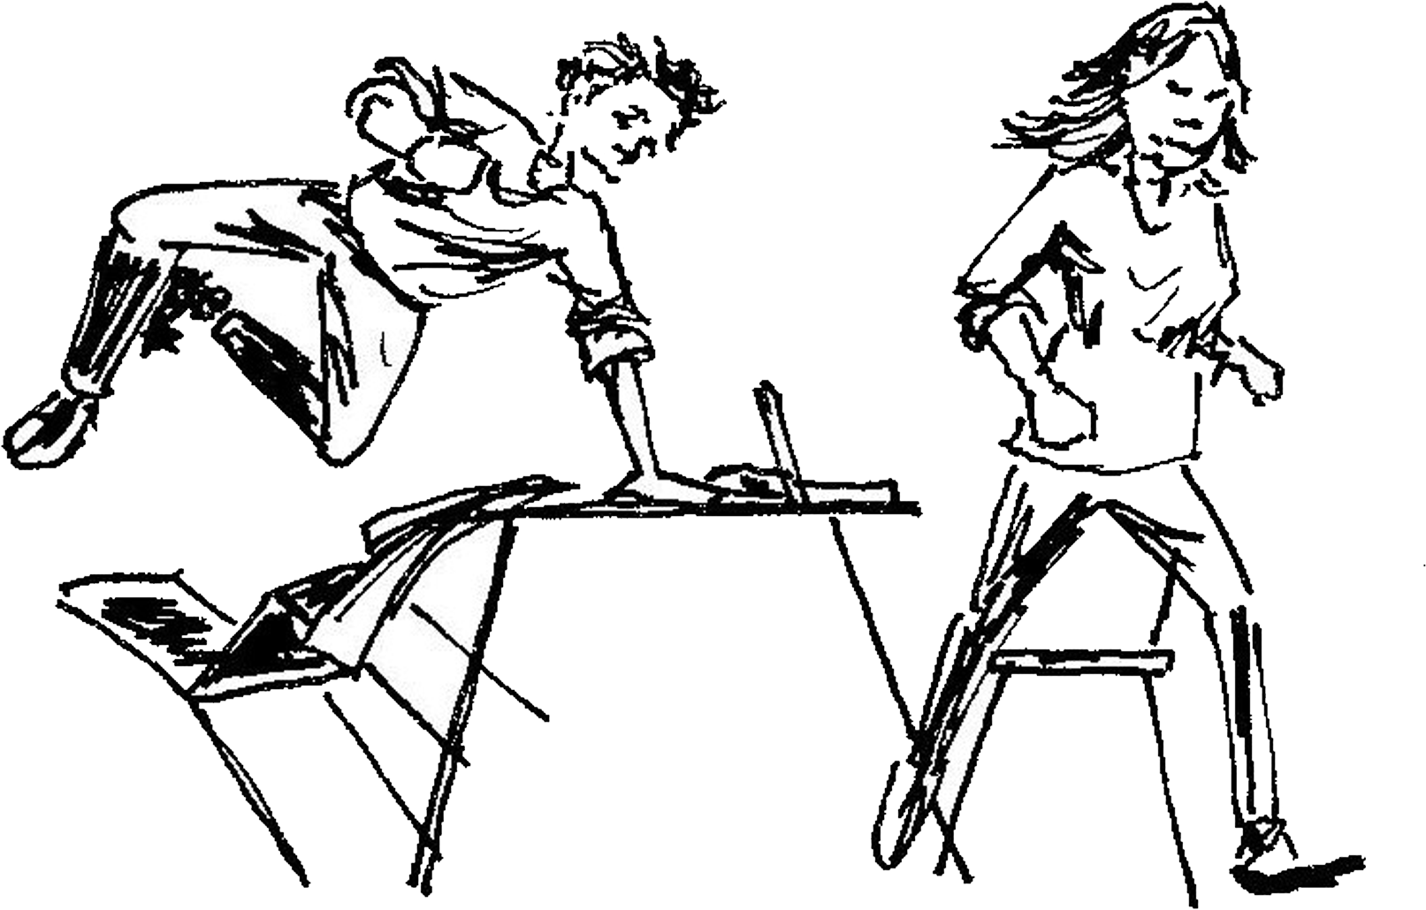
Why university education for Sustainable Development?
Until now, we have achieved no breakthrough in dealing successfullywith global challenges. Continuing with a «business as usual» approach or just limiting action to minor adaptations and slight modifications of our behaviour will not lead to SD. Today the debate on sustainable development is requiring great transformations.
UniBe graduates assume positions of responsibility in research, teaching, administration, private industry, civil society, or politics.
This means: all graduates of the University of Bern can substantially help shape SD and a transformation in many places!
It is no longer just about having «informed citizens»: it’s about reflective, innovative, and forward-looking actors who participate actively and take on responsibility.
ESD does not replace existing courses, but complements them!
Education is not the filling of a barrel, but the lighting of a fire. (adapted from Plutarch)
Notes:
Knowledge is an important contribution to SD. In addition, the Swiss Government’s Strategy for Sustainable Development (Nachhaltige Entwicklung 2016-2019, p. 31) emphasizes in its long-term vision the importance of competence building in the framework of Education for Sustainable Development (ESD), aiming for example to promote independent thinking and action, to strengthen one’s own and societal resilience, to recognize the importance of SD, and to actively and reflectively participate in shaping SD.
At the University of Bern, ESD is intended to enable students to think in terms of networks and connections, to understand complex society–environment interactions and processes, and to come up with hypotheses about causes and possible effects of such processes. This approach also makes it possible to formulate and justify sustainability goals, to develop appropriate measures for their implementation, and to review their effectiveness.
Seen this way, ESD is “categorial education” in the dual sense that learners learn (i.e. access) reality through their own efforts at the same time as they empower themselves to understand and shape this reality through these very efforts (Klafki 2003). This is why, in the discussion on ESD, the development of competences plays a key role.

Slide 5
Integrating SD: different levels of intensity
in courses und study programmes
Examples from the University of Bern
‘Bolt-on’ approaches – education about sustainability
Individual lessons: Students know the link between their own discipline and SD; they are able to make disciplinary contributions to SD.
‘Build-in’ approaches – education for sustainability
Courses: Students are able to use their disciplinary skills in an interdisciplinary team to make a joint contribution to SD; also relevant in modules with application-orientation.
Curriculum redesign – sustainable education
Study programmes: Students develop inter- and transdisciplinary skills and apply them as interdisciplinary teams in cooperation with practitioners.
Continuing education: Lecturers develop thematic and didactic skills relevant for SD and apply them in education for SD.
Within a course related to SD
e.g. Applied Integrative Geography
(Institute of Geography)
e.g. Bachelor Minor Sustainable Development (CDE)
e.g. Workshops with thematic and didactic components (CDE, HD, iLUB)
Adapted from Sterling and Thomas 2006
Notes:
There are several ways to develop SD-relevant competences in university teaching. Sterling and Thomas (2006) describe various levels of intensity of integrating SD into teaching – from incorporating it into individual lessons to offering entire courses or even redesigning entire study programmes.

Slide 6
SD-relevant educational content, skills, teaching–learning arrangements
Step 1: Identify educational content for Sustainable Development
1a: Create thematic links between SD and your discipline
1b: Define disciplinary contributions to SD and reflect on epistemological boundaries of your discipline
Step 2: Decide on competences
2a: Define educational foci in the framework of «knowledge, skills, willingness»
2b: Differentiate between disciplinary and interdisciplinary skills
Step 3: Design and develop teaching–learning arrangements
3a: Identify the intensity of the learning processes you are aiming for
3b: Find ways of developing SD-relevant teaching–learning events, e.g.…
Cognitive activation in lectures
Activating seminar methods
Scripts on university education didactics

Slide 7
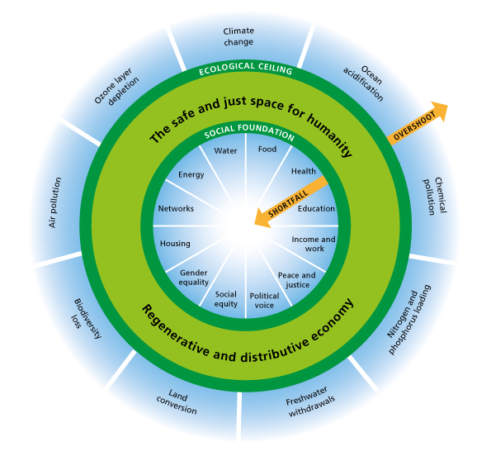
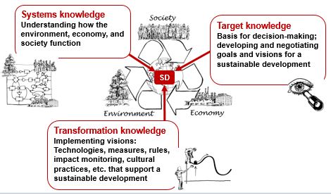
Educational content
Identifying thematic links between your own discipline and SD
a: Take the Doughnut Model and/or the UN Sustainable Development Goals to identify links between your discipline and Sustainable Development.
Guiding questions:
What thematic areas offer your discipline relevant anchoring points?
What are your topics of research (actual and possible)?
Are there further SD-relevant topics that could be interesting for your discipline but are not contained in either of the two models?
What dimensions of SD (environmental, sociocultural, economic) do your topics take into account?
Which actors and other scientific disciplines would be interesting partners for collaboration?
Is there a relation to practice and if so, what does it consist of?
b: You can identify contributions to a certain topic based on three forms of knowledge for SD.
Notes:
Possible educational contents of SD-relevant courses result from the connection between the thematic and epistemological focuses of a scientific discipline on the one hand, and SD on the other. In some disciplines such links are obvious; in many disciplines the link is implicit but not explicitly mentioned; in other still it still has to be identified.
We propose using SD models and conceptional frameworks pragmatically. Simple models (e.g. with three dimensions of SD) allow an introduction to the subject, but ignore many important aspects or don’t make them explicit. Complex models contain fewer gaps, but are difficult to communicate.
No template will be able to contain all connection possibilities of all disciplines. But models and concepts need not be discarded immediately, if your discipline and its topics are not obvious. Instead, they should be seen as an encouragement to supplement important aspects and perspectives.
This exercise is a way of identifying the links between SD and your discipline – e.g. by students. The models on the following slides can be used for this purpose.

Slide 8
Educational content
The Doughnut Model of Sustainable Development
Source: 9 Dimensions of planetary boundaries according to Rockström et al. 2009, 12 dimensions of social boundaries according to Raworth 2017, based on government priorities at Rio+20 and later UN Conferences.
Notes:
The Doughnut Model
The Doughnut Model (Raworth/Oxfam 2012; updated by Raworth 2017) is an attempt to concretize the general dimensions of Sustainability and thus to operationalize SD. To this end, Raworth first links the concept of SD to the international scientific and political debate on planetary limits on the use and degradation of natural resources (Rockström et al. 2009). In her model, Raworth expands the debate to include minimum thresholds of social and economic foundations that must not be exceeded, to allow all people to live a worthwhile life.
The area of Sustainable Development that is environmentally safe, socially just, and economically viable for humanity is symbolized by the light green area. There is no precise “prescription” as to how SD should look. The model is based on an understanding of SD as a search, learning, and shaping process involving all of society and thus requiring the participation of every individual. The model does not pre-empt this negotiation process, but indicates possible paths towards SD within the light green corridor. This area is enclosed by two “guard rails”, which depict threats to SD. The outer rail shows the “planetary boundaries”, whose natural resources (water, air, land, biodiversity etc.) are being massively degraded by human use. The inside rail comprises the “social foundation”, i.e. the minimum requirements without which human well-being is not possible.
The limits of environmental degradation and the minimum socio-economic requirements are not universally defined, and the indicators for measuring current values and trends are the topic of ongoing research and negotiations between various actors with different interests and levels of influence. Political decisions on steering future developments are based on information including prominent scientific contributions to the collection of environmental, sociocultural, and economic systems and their dynamics.

Slide 9
Educational content
The UN SDGs – approved on 25.9.2015 by the 193 UN member states
No Poverty - End poverty in all its forms everywhere
Zero Hunger - End hunger, achieve food security and improved nutrition and promote sustainable agriculture
Good Health and Well-being - Ensure healthy lives and promote well-being for all at all ages
Quality Education - Ensure inclusive and equitable quality education and promote lifelong learning opportunities for all
Gender Equality - Achieve gender equality and empower all women and girls
Clean Water and Sanitation - Ensure availability and sustainable management of water and sanitation for all
Affordable and Clean Energy - Ensure access to affordable, reliable, sustainable and modern energy for all
Decent Work and Economic Growth - Promote sustained, inclusive and sustainable economic growth, full and productive employment and decent work for all
Industry, Innovation and Infrastructure - Build resilient infrastructure, promote inclusive and sustainable industrialization and foster innovation
Reduced Inequalities - Reduce income inequality within and among countries
Sustainable Cities and Communities - Make cities and human settlements inclusive, safe, resilient and sustainable
Responsible Consumption and Production - Ensure sustainable consumption and production patterns
Climate Action - Take urgent action to combat climate change and its impacts by regulating emissions and promoting developments in renewable energy
Life Below Water - Conserve and sustainably use the oceans, seas and marine resources for sustainable development
Life on Land - Protect, restore and promote sustainable use of terrestrial ecosystems, sustainably manage forests, combat desertification, and halt and reverse land degradation and halt biodiversity loss
Peace, Justice and Strong Institutions - Promote peaceful and inclusive societies for sustainable development, provide access to justice for all and build effective, accountable and inclusive institutions at all levels
Partnerships for the Goals - Strengthen the means of implementation and revitalize the global partnership for sustainable development
http://www.un.org/sustainabledevelopment/sustainable-development-goals/
Notes:
The UN Sustainable Development Goals
In 2000, the UN, World Bank, International Monetary Fund (IMF), and Organization for Economic Cooperation and Development (OECD) formulated eight Millennium Development Goals (MDGs). Both the goals and the way they were set were controversial. The selection was criticized as being incomplete, defined by industrialized countries, lacking binding commitments and coordination of the individual targets, and characterized by unrealistic indicators and target sizes.
Based on this criticism as well as on the intention to unite global environmental policy and poverty reduction in a single initiative, the UN Sustainable Development Goals (SDGs) were formulated – and approved on 25 September 2015 as the «2030 Agenda for Sustainable Development», by the 193 member states of the UN. The SDGs are broad-based and form the global political basis for SD efforts in the coming years.

Slide 10
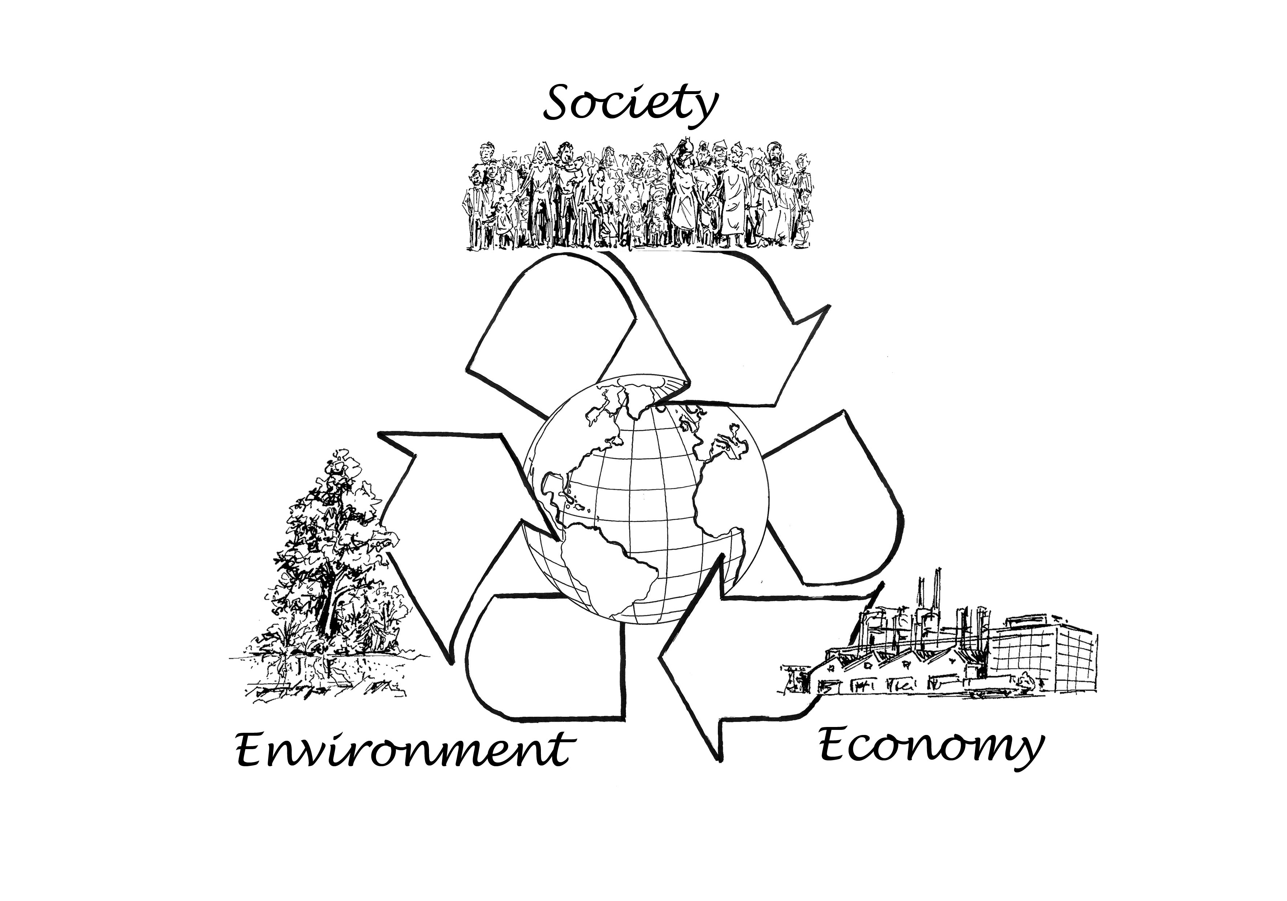
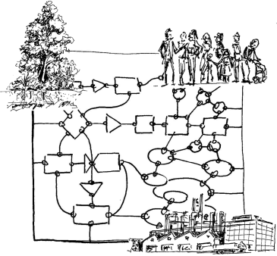
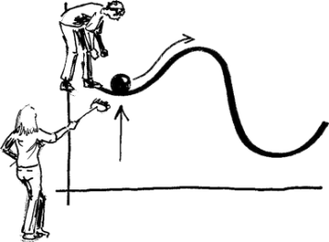
Forms of knowledge relevant to SD
Systems knowledge
Understanding how the environment, economy, and society function
Target knowledge
Basis for decision-making; developing and negotiating goals and visions for a sustainable development
SD
Transformation knowledge
Implementing visions: Technologies, measures, rules, impact monitoring, cultural practices, etc. that support a sustainable development
Based on ProClim/CASS 1997, Pohl & Hirsch Hadorn 2007 Graphics: K Herweg
Notes:
Finding out how and where your discipline is connected with the Doughnut Model or the UN SDGs can help you position it with respect to SD. These are starting points to highlight existing ways in which your discipline refers to SD and identify possible anchoring points. Once the thematic links are made, these can be further concretized by asking which forms of knowledge are important in that particular discipline with respect to SD.
Systems knowledge — Understanding how the environment, society, and economy function – individually, or as complex interactions;
Target knowledge — Scientific contributions to decide the direction in which these relations can be steered towards a sustainable development; and
Transformation knowledge — Scientific contributions to implementation, e.g. in the form of rules, solutions, measures, cultural practices, or technologies to promote sustainable development; this includes monitoring and a review of goal achievement with disciplinary and interdisciplinary scientific methods.
In principle, each discipline can contribute to all three forms of knowledge, albeit to varying degrees. Concretizing the links in this way requires an examination of, or reflection on, the scientific understanding of one’s own discipline. While systems knowledge is the core business of many scientific disciplines, target and transformation knowledge are normative, value-laden categories. To capture as many of their entry points to SD as possible, every discipline should try to identify contributions to all three forms of knowledge. This distinction is heuristic, i.e. it is not the final categorization which is decisive, but the process of reflecting on the relation between scientific work and SD.

Slide 11
Educational content
Examples: Links between scientific disciplines and SD
Systems knowledge
Systems understanding: Environment, Society, Economy Global change, climate, impact of climate change Ecosystems, functions, conditions for plant growth, biodiversity, nutrient and pollutant cycles Variability, vulnerability, resilience of ecological systems Raw materials, deposits, material properties Degradation and sustainable use of renewable resources Contaminated-site clean-up, storage of nuclear waste Use of renewable energies, technologies, biotechnology Mathematical methods, quantitative analysis, statistics, stochastics, developing SD models, data evaluation and processing Political processes, links between political parties and organizations Formal and informal institutions, tools, and processes of political opinion formation Rights and laws related to SD-relevant areas Instruments for political influence Relationship between individual/society – the state and how it is changing in the course of globalization Social ecological systems, human–nature interface ...
These examples are based on the contributions of various authors of the Guidelines: «Integrating Sustainable Development into higher education» and on answers by students to the BScMiSD exam question: «what contributions could your major make to Sustainable Development?».

Slide 12
Educational content
Examples: Links between scientific disciplines and SD
Systems knowledge
Historical understanding of the transformation of traditional societies and their relationship to nature Diverse social and power structures, cultures (values, norms, religion) Different values Ethnic and political causes of resource conflict Forms and sources of social inequality, causes of poverty Language as a heritage of cultural history; sociolinguistic research (e.g. on justice) Use of language and linguistic structures in international negotiations Rhetoric und linguistic logic; discourse analysis to understand power structures Theatre performances (e.g. of debates); different forms of alienation from and communication about SD Understanding, treatment of complex topics Media usage, media reception, dissemination of important information, advertising, behavioural patterns Human action, behaviour, cognition of the environment, society, economy, decision-making Health, prevention, well-being, the role of sports and physical activity Human and animal health Medicinal plants Personality psychology, crime, and violence Ways of functioning of various economic systems, economic paradigms, economic models Econometrics Influence of growth-based economy and global trade on SD and global disparities Post-growth economy Externalities Risk minimization vs profit maximization, money-free societies Corporate structures, entrepreneurial motivations, business models of cost transparency, potential for savings ...
These examples are based on the contributions of various authors of the Guidelines: «Integrating Sustainable Development into higher education» and on answers by students to the BScMiSD exam question: «what contributions could your major make to Sustainable Development?».

Slide 13
Educational content
Examples: Links between scientific disciplines and SD
Target knowledge
Value of nature conservation Quantifiable guidelines and values, mathematical calculation of planetary boundaries, resource efficiency Transfer of principles of the functioning of nature to other sustainability dimensions Political visions, state forms, government systems, legal liabilities – role model, best practices Model «social contracts», sustainability-oriented legislation, and institutions Visions based on knowledge of historically sustainable and non-sustainable developments Alternative processes or goal-setting for Sustainable Development, development scenarios Spatial planning Ethics, values, and justice Description of cultural sustainability, scenarios, and potential worlds Variety of SD understandings, different level of importance of SD in different societies Visions, parameters, and indicators for justice, equality, redistribution Social standards of a globalized society, solidarity societies Promotion of language as a part of cultural identity Reduction of discrimination on the basis of language, visions on equality of all languages and dialects Global access to open data for all population strata Educational goals, goals for psychological health and satisfaction of needs Supra-individual parameters for well-being, context-specific indicators of a «good life» and social welfare Sustainable tourism, recreation, nature experiences, recovery/relaxation, socio-cultural sustainability Models, values, and economic systems that contribute to reducing disparities and inequalities of distribution Alternative business models Sustainable entrepreneurial visions, responsibility of multinational companies, internalization of costs Key figures (economic efficiency, environmental protection, emission rates, social compatibility), stress limits of the ecosystem and society Change in consumption patterns ...
These examples are based on the contributions of various authors of the Guidelines: «Integrating Sustainable Development into higher education» and on answers by students to the BScMiSD exam question: «what contributions could your major make to Sustainable Development?».

Slide 14
Educational content
Examples: Links between scientific disciplines and SD
Transformation knowledge
Scientific monitoring systems Compilation of environmental, social, and economic indicators in the assessment of SD Development of appropriate monitoring methods, standards Development of interpretation and assessment procedures Modelling (climate, energy, consumption, transport, infrastructure, population etc.), simulation models, efficient algorithms, creating scenarios Forecasts on the progress of SD, predictions, dynamic modelling of trends, stability calculations, and modelling of measures against natural catastrophes, etc. Analyses with local-specific SD indicators and indigenous methods Verification of achievement: environmental compatibility, social compatibility, profitability Resource efficiency, sustainable technologies Optimization of plant production, e.g. Development of properties to increase resistance to climate change and environmental changes Resource protection, remediation of contaminated soils through phytoremediation, regeneration of plant communities and animal species, water protection Rocks as energy carriers, availability of non-renewable natural resources SD-relevant technology development, technologies for use of alternative energies, solar, wind, geothermal energy, etc. Low-cost/high-tech solutions, use of environmentally friendly materials Development of participatory processes, consensus/negotiation solutions, coalitions, and majority formation Taxation systems (energy, labour), monetary evaluation of ecosystem services, certifications Historical SD considerations as an educational contribution Mediation of values, ethics; Potential of spirituality for SD Social learning processes, awareness-raising, environmental awareness, value change, incentive systems Migration & Integration (e.g. through sports) Sufficient lifestyles and consumption patterns (reduced resource consumption) ...
These examples are based on the contributions of various authors of the Guidelines: «Integrating Sustainable Development into higher education» and on answers by students to the BScMiSD exam question: «what contributions could your major make to Sustainable Development?».

Slide 15
Educational content
Examples: Links between scientific disciplines and SD
Transformation knowledge
Language education for broad population sectors worldwide, strengthen educational foundations in the global South, from primary school to the publication level of researchers «Agreed language», i.e. agreed-upon terminology as the basis for successful negotiations, understanding, teamwork Communication, negotiation, argumentation, presentation, vocal training, comprehensible transmission of complex connections Theatre and music stages as experimental arenas; promoting the knowledge base, participation and voice in SD Literature and media as transmitters of knowledge and as activation instruments, SD as utopias, fictional literature Poetry as a creative school of thought connecting people Development of new communication channels, use, and valuation of new media Filtering and dissemination of information, knowledge processing, informatics, and communication Improved science communication (in particular, improved access to knowledge in the global South) Communications technology, access to comprehensible information, North-South networks, communications strategies Training in solution-oriented inter- and transdisciplinarity Motivation of individuals and society to commitment to SD, acceptance for the lowering of living standards in industrialized countries Strengthening the One-Health concept (combined human and animal health) in areas with mobile and sedentary populations Migration and integration (e.g. through sports) Alternative economic systems, legal regulations, steering fees, market regulation, incentive systems Environmental, social, and economic innovations with the potential of promoting SD Employment models with fair wages and working conditions, entrepreneurial alternatives, sustainable business processes Adaptive management, change management, personnel management, leadership styles Implementation of prevention/«polluter pays» principles Sustainable event management, sport tourism ...
These examples are based on the contributions of various authors of the Guidelines: «Integrating Sustainable Development into higher education» and on answers by students to the BScMiSD exam question: «what contributions could your major make to Sustainable Development?».

Slide 16
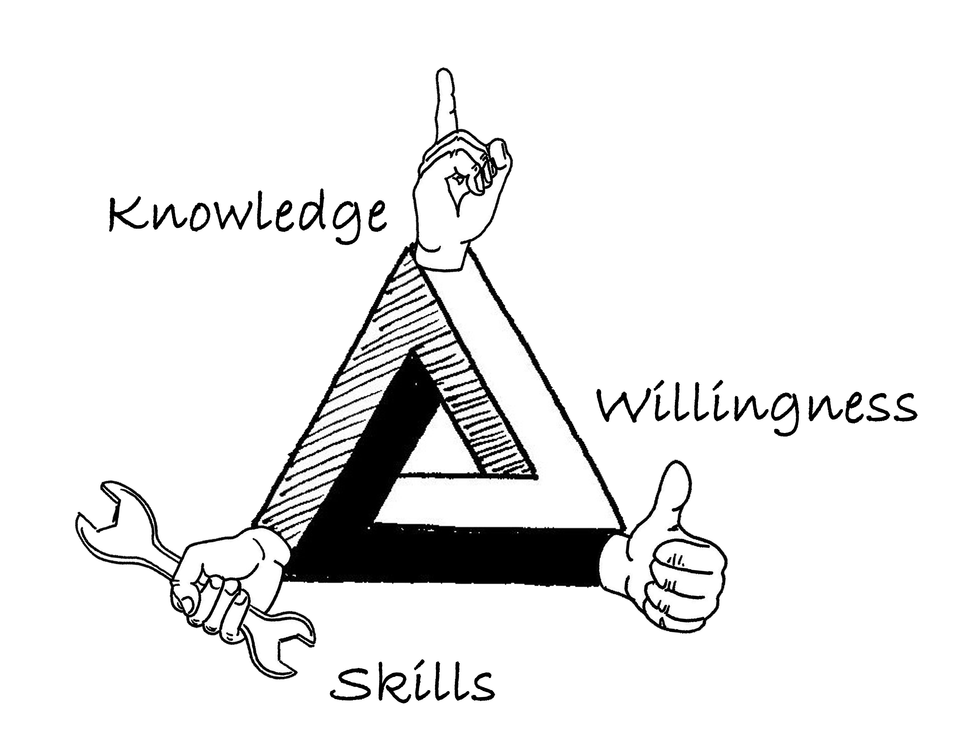
Competences
Attitudes
Values
Competences
Rychen and Salganik 2003 | Knowledge | Competences | Attitudes and values
Schubiger 2013 | Knowledge | Skills | Willingness
Notes:
Within ESD we refer to the definition of «competence» by Weinert (2002: 27-28), according to which competences are “cognitive abilities or skills which individuals have or can acquire to solve specific problems, as well as the related motivational, volitional (conscious, deliberate), and social willingness and abilities to apply solutions in variable situations successfully and responsibly”.
Having “competences” can thus be seen as a prerequisite for action on the one hand; on the other, this very action may be necessary to make the competences visible (Schubiger 2013). In view of SD, it is not only the potential for action but also action itself and the conditions under which action takes place that are important. SD and social cohesion are crucially determined by the competences of the whole population, and at university level it is useful to have a comprehensively defined concept of “competence” that includes knowledge, skills, attitudes, and values (Rychen and Salganik 2003; Stoltenberg and Burandt 2014).
To actively participate in societal transformation, students need not only knowledge and skills but also a corresponding attitude (mindset, values) and the willingness to change (Schubiger 2013).

Slide 17
Competences
Knowledge and skills are developed and tested in lessons/courses.
Willingness often only manifests itself outside of, or after, one’s studies.
Nonetheless, willingness can be stimulated in lessons/courses:
Generating systems knowledge, e.g. Showing non-sustainable development
Triggering empathy, e.g.
Promoting a sense of responsibility (I want to do something myself)
Showing and developing realistic options for action
Unsustainable
development
paths
Empathy
Responsibility
Options
Haversath 2012; Schubiger 2013; Graphic: K Herweg
Notes:
While knowledge and skills can be formulated, built up, and tested within the framework of lessons as learning outcomes, attitudes, values, and willingness often only manifest themselves in actions outside of, or after, one’s studies. But the dimension of “willingness” is essential in a search, learning, and shaping process. According to Hattie (2009: 254), “Education is … never neutral, and its fundamental purpose is intervention or behaviour change. This is what makes teaching a moral profession.” The “willingness” – or, more precisely: wanting to implement knowledge and skills – cannot be tested in a course, but it can be stimulated, by discussing attitudes, mindsets, and values with the students. If systems knowledge is built up at the same time, concern is triggered, a sense of responsibility is promoted (“I want to do something myself”), and realistic options for action are demonstrated and developed (Haversath 2012; Schubiger 2013) – subsequently, the chances improve that knowledge and skills also lead to action.
It is important to emphasize that SD is «not a code of conduct, but an individual and societal search, learning and shaping process with the right to negotiate the best solutions under the ethical principle of a sustainable development» (Stoltenberg und Burandt 2014: 568, our translation). Thus, when searching for ways of building competences, we are not looking for how to force certain SD values onto students, but for how to enable them to actively participate in this search, learning, and shaping process and to acquire the necessary scientific knowledge to support this process. The development of disciplinary and interdisciplinary competences essential for Sustainable Development can only be achieved through a variety of teaching and learning forms. Both courses that teach the necessary disciplinary knowledge and courses enabling development of other competences, such as team skills, the taking on of responsibility, or communication, are necessary.

Slide 18
Disciplinary and cross-disciplinary competences
 | Competence | Examples
Disciplinary competences | Disciplinary knowledge and methodologies | Applying disciplinary knowledge Using disciplinary methods where appropriate; analysing and interpreting data Developing ways to measure and collect data Developing appropriate conceptual frameworks …
Cross-disciplinary competences | SD-relevant inter- und transdisciplinary knowledge and methodologies | Acquiring and using inter- und transdisciplinary knowledge (e.g. systems connections between biophysical and socio-economic processes) Building up a basic understanding of different scientific traditions Thinking in terms of connections, in a networked, forward-looking way (formulating impact hypotheses) Developing integrative concepts to measure and collect data in a way that includes environmental, economic, and sociocultural dimensions. Applying inter- and transdisciplinary methodologies appropriately, to capture, analyse, and assess complex conditions, developments/changes, and trends Dealing critically and reflectively with one‘s own scientific values Dealing with incomplete knowledge and uncertainties in complex systems …
 | SD-relevant competences (personal, social, and action-related) | Targeted use of organizational and management skills Collaborating in teams of scientific actors, managing conflict Communicating appropriately with actors from other disciplines Developing awareness of responsibility, possibly taking over management tasks Jointly planning projects and implementing them innovatively (creation and action) Taking decisions jointly in view of SD Test actions in view of their environmental and social-cultural compatibility as well as economic feasibility …
Notes:
The main focus of university education is to enable students to acquire disciplinary and methodological knowledge to be successful in their respective discipline and in later academic and other professional fields. But to more actively shape SD, additional qualifications are required. ESD is intended to enable emerging scientists to participate – creatively and responsibly, in an interdisciplinary and communicative way and on the basis of sound knowledge about complex questions of the future – in creating a present and future in line with SD. SD requires trade-offs between ecological, social, and economic interests. For a transparent negotiation of these trade-offs, scientifically robust basic principles are indispensable. At the same time, ESD works at the tertiary level in the knowledge and responsibility that scientific analyses are always subject to great uncertainties due to the complexity and dynamics of current problems.
Even if a scientific education already includes many competences that are directly or indirectly relevant to SD, some of the skills needed for SD are rarely explicitly developed, or only in certain courses. As not all competences can be developed in all course or lesson forms, it is useful to differentiate between these competences for a better overview. The division and compilation (based on Erpenbeck 2009) does not claim to be complete. It is also not our goal to discuss or criticize various competence models. The differentiation between disciplinary and cross-disciplinary competences – that encompass knowledge, skills, attitudes, and values – seems pragmatic to us in the academic world. The examples listed in the table serve as suggestions, from which a suitable and manageable selection can be made for individual courses; note that this selection should be customized for your own needs.

Slide 19
SD-relevant competences
Examples from the topic of sustainable resource use
 | Competence | SD-relevant competences
Knowledge | Disciplinary, interdisciplinary, and transdisciplinary knowledge and methodologies | Recognizing the extent, causes, and consequences of the degradation of natural resources (water, biodiversity, land) Capturing processes and dynamics, including rebound effects Know, understand, and apply methods on capturing the above Know and understand measures for a more sustainable resource use (technology development, institutional framework conditions, implementation approaches, education and further training, cultural practices, etc.) …
Skills | Skills | Work out complex relationships independently Develop and apply analytical instruments and measurement methods for capturing SD-relevant variables Capture, assess, and scientifically describe the impact of different measures on SD Work out inter- and transdisciplinary concepts and innovative interventions on resource protection Communicate research concepts and results from science and practice in a comprehensible way …
Willingness | Mindset, values, attitude | Evaluate the interactions between resource use and its social and economic framework conditions while taking into account different values Recognize power constellations and injustices that lead to a non-sustainable development From the above, develop empathy for those affected Build up motivation to commit to SD and take on responsibility Act, e.g. come up with contributions to minimize or reverse negative developments and solutions to problems, develop and implement realistic options for action, ideas and projects on SD; evaluate their effectiveness and adjust them …
Notes:
How to promote SD-relevant competences depends above all on the thematic connection of a discipline to SD, as well as the systems, target, and transformation knowledge derived from this discipline for SD. Within this combination, three categories of competence - knowledge, skills, and willingness - are each assigned concrete examples of sustainable resource use. The examples have been formulated as learning outcomes, based on the five components of the Dublin descriptors (JQI 2004):
Knowledge and understanding
Applying knowledge and understanding
Making judgements
Communication
Lifelong learning ability

Slide 20
Identifying the desired intensity of the learning processes
Level | Contents, goals | Characteristics
1st order learning: conformative | Efficiency and effectiveness: doing things better | • Changes within established (disciplinary) boundaries • Learning about something • Knowledge transfer cognitive dimension: intellect
2nd order learning: reformative | Check and amend underlying assumptions: doing better things | • A significant change in thinking • Critically questioning and then adapting beliefs, values, assumptions, etc. affective dimension: emotions
3rd order learning: transformative | Paradigm shift: Seeing things differently | • Being aware of one’s world view, which among other things led to the decision to study a particular subject. • Reflection on, and possibly reconstruction of, scientific paradigms • Allow significant shift in awareness existential dimension – reflecting on (and possibly reconstructing) individual and group self-understanding empowerment dimension action dimension
Sterling 2011 (building on Bateson 1972)
Notes:
Efforts to date have been insufficient to solve the major challenges and problems of our society, economy, and environment. Sustainable Development requires more significant changes. This means that existing research and education concepts and processes should be analysed to find out whether they promote SD or not (Tilbury 2011).
In a lesson or course, the intensity with which understanding, educational content, knowledge production, paradigms, etc. are taken into consideration depends on your discipline and your willingness to increase its relevance to SD. Stephen Sterling’s (2001) three-step understanding of levels of learning – conformative, reformative, and transformative learning – is helpful in this respect. At level 1 (conformative learning), the focus is mainly on promoting «knowledge» and «skills». For «willingness», levels 2 (reformative learning) and 3 (transformative learning) are decisive, as these address the attitude and mindset of students regarding SD.
At levels 2 and 3, students will engage with SD as a goal to be reached after negotiating it: SD needs to be understood here not as a «code of conduct», but as an individual and societal search, learning, and shaping process that aims at negotiating best solutions under the ethical principles of Sustainable Development (Stoltenberg und Burandt 2014: 568). This means that students should not have SD values imposed on them. Instead, teaching strategies need to enable them to actively participate in this search, learning, and shaping process, and to acquire the necessary scientific knowledge to support this process. This can only be achieved through a range of teaching and learning forms which help to transmit the necessary disciplinary knowledge on the one hand, and help develop other competences, such as those needed for teamwork, taking responsibility, or communicating.

Slide 21
SD-relevant competences
Examples from the topic of natural resource use
Level of learning | Examples with a relation to SD
Conformative | Transfer of abstract factual knowledge, trends, terminologies, etc. (cognitive dimension) Disciplinary analysis of individual questions in relation to the topic of sustainable use of natural resources, e.g. measuring and capturing water balance, composition of plant communities, soil erosion, farmers’ action and decision patterns; cost-efficiency analysis of protective measures, perception analysis of SD-relevant objects, actions, and institutions, historical understanding of SD, discourse analysis of legal instruments from the local to the global level, etc. Further development of disciplinary theoretical foundations and data collection methods Type of teaching-leaning event: e.g. lecture, experiment, seminar
Reformative | Examining, in an interdisciplinary way, the Sustainability dimensions of environmental compatibility, social compatibility, and economic feasibility and becoming emotionally aware of social and economic injustices as well as environmental degradation (affective dimension) Familiarizing oneself with the epistemologies of different disciplines and their potentials and limitations. Developing interdisciplinary theoretical foundations and data collection methods Type of teaching-leaning event: e,g. interdisciplinary experiment, seminar
Transformative | Test the limits of scientific inquiry when negotiating solutions for SD; accept that scientific and non-scientific knowledge have equal value and integrate both into the research process Development of a personal sense of responsibility and intention to act (empowerment dimension) Action knowledge and the active co-shaping of SD, e.g. through transdisciplinary projects (action dimension) Contribute to social justice by including other actors in the formulation of one’s research questions Improve communication between actors Remove the fact-value dichotomy Improve the theoretical foundations of transdisciplinary research and data collection methods Question one’s own values and world view (existential dimension) Type of teaching-leaning event: e,g. field course, excursion, internship, project work

Slide 22
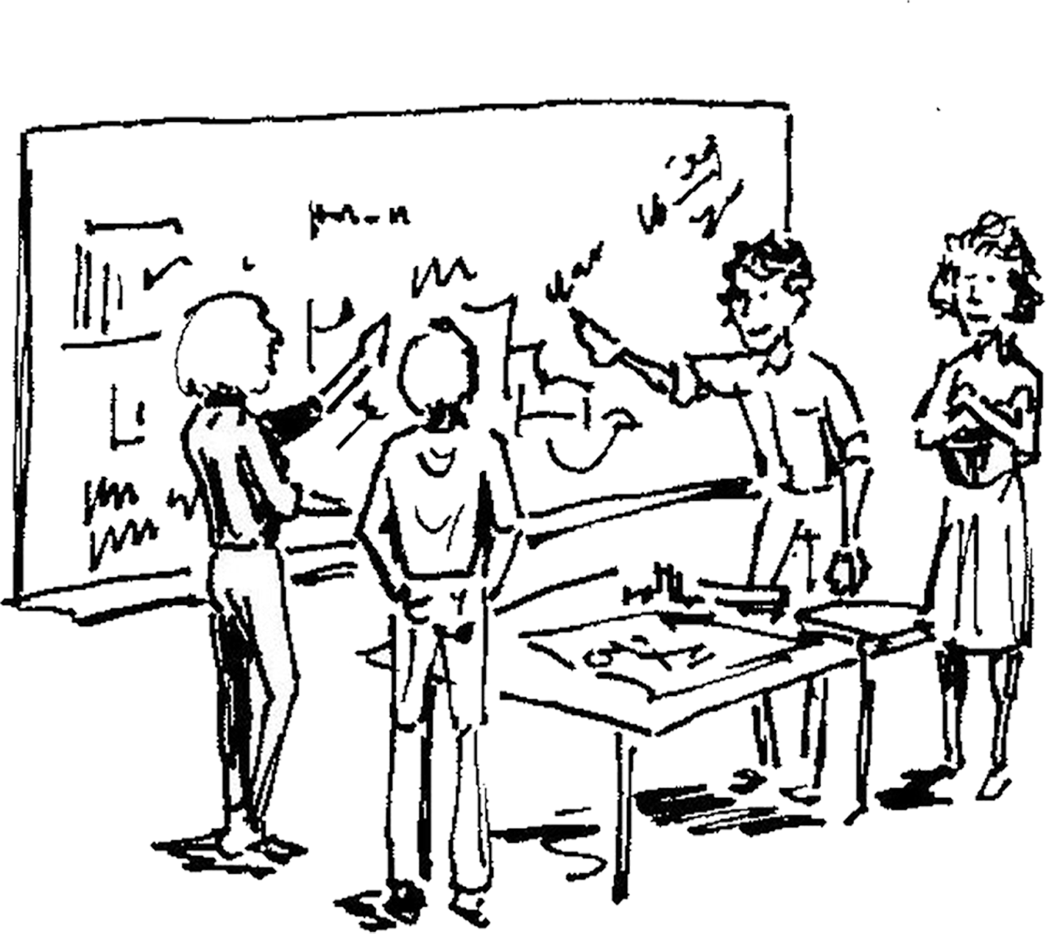
Teaching–learning arrangements
Developing SD-relevant competences through diversity
Development of disciplinary knowledge and methodological competences can be achieved through courses of the kind usually taught at university level
Development of SD-relevant inter- and transdisciplinary knowledge and methodological competences, as well as SD-relevant personal and social skills and the competence to act, requires courses or projects, that…
… enable students to take a more active role,
… bring together students from various disciplines,
… allow students to interact with actors from practice.
Notes:
Building disciplinary and interdisciplinary competences that are vital to Sustainable Development can only be achieved through a multitude of teaching and learning forms. There is a need for learning events or courses that transmit the necessary disciplinary knowledge, as well as courses which additionally offer development of competences such as teamwork, responsibility, or communication.
It is clear that it is easier to involve students actively in seminars and field courses than in lectures with over a hundred participants. Nevertheless, it is possible to reach, stimulate, and activate students in all forms of courses . A detailed description of the corresponding methods, including guidance and explanations on preparation, process, potential, variations, examples, and tips can be found at www.esd.unibe.ch (In-depth module 1, chapter 3, currently only available in German). Of course, these methods are not limited for use in SD. However, they are well-suited to SD teaching, as in addition to dealing with the topic, they also help to develop important personal, social, and action-related competences.

Slide 23
Teaching–Learning arrangements
Factors of improved learning – the TAFEL principle
Transparent Expectations
Communicate from the start what students are excepted to master after the course (Learning Outcomes) and the assessment criteria based on this
Activating teaching strategies
Use of a broad spectrum of activating teaching and learning methods
Students actively work on issues based on real-world problems
Students examine how they learn and work (implementing meta-cognitive strategies)
Feedback, Evaluation, Learning scenario
Offer of prompt feedback on learning progress: information on students’ achievements and how they got there, rather than praise, criticism, or reward
Use of different methods to obtain a picture of students’ current level of learning, and, if necessary, adjustment in teaching (adaptive teaching competence)
«Three claims for higher education» according to Hattie 2011
Notes:
In his book “Visible Learning”, John Hattie presents the findings of a meta-analysis of 52,000 studies conducted over twenty years (in the meantime, more than 60,000 have been collected). Hattie ranked 138 factors that influence learning success, based on their effectiveness (Hattie 2009). Focusing on university education, he put forth three central claims (“three claims for higher education”; Hattie 2011).

Slide 24
References
Erpenbeck J. 2009. Was «sind» Kompetenzen? In: Faix WG, hrsg. Kompetenz. Festschrift Prof. Dr. John Erpenbeck zum 70. Geburtstag. Stuttgart: Steinbeis-Edition, pp. 1–57. Hattie J. 2009. Visible Learning: A Synthesis of Over 800 Meta-analyses Relating to Achievement. London: Routledge. Hattie J. 2011. Which strategies best enhance teaching and learning in higher education? In: Mashek D, Hammer EY, hrsg. Empirical Research in Teaching and Learning. Oxford: Wiley-Blackwell, pp. 130–142. Haversath JB. 2012. Geographiedidaktik: Theorie-Themen-Forschung. Braunschweig: Westermann Verlag. JQI [Joint Quality Initiative]. 2004. Gemeinsame “Dublin Descriptors” für Bachelor-, Master- und Promotionsabschlüsse. Entwurf 1.31 Arbeitspapier auf der JQI Tagung in Dublin am 23.3.2004. Dublin: JQI. Klafki W. 2003. Allgemeinbildung heute – Sinndimensionen einer gegenwarts-und zukunftsorientierten Bildungskonzeption. In: Berg HC, hrsg. Schulmanagement. Handbuch. Bern: hep Verlag, pp. 11–28. Pohl C, Hirsch Hadorn G. 2007. Principles for Designing Transdisciplinary Research. Translated by AB Zimmermann. Munich, Germany: oekom. Proclim/CASS [Konferenz der Schweizerischen Wissenschaftlichen Akademien]. 1997. Visionen der Forschenden: Forschung zu Nachhaltigkeit und Globalem Wandel – Wissenschaftspolitische Visionen der Schweizer Forschenden. Bern: ProClim, Forum für Klima und Global Change, Schweizerische Akademie der Naturwissenschaften. Raworth K. 2012. A Safe and Just Space for Humanity. Can We Live Within the Doughnut? Cowley, Oxford: Oxfam. https://www.oxfam.org/sites/www.oxfam.org/files/file_attachments/dp-a-safe-and-just-space-for-humanity-130212-en_5.pdf; 20.04.2016. Rawoth K. 2017. What on Earth is the Doughnut?… Exploring Doughnut Economics. https://www.kateraworth.com/doughnut/; 27.08.2017. Rockström J, Steffen W, Noone K, Persson A, Chapin FS, Lambin EF, Lenton TM, Scheffer M, Folke C, Schellnhuber HJ et al. 2009. A safe operating space for humanity. Nature 461(7263):472–475. Rychen DS, Salganik LH, hrsg. 2003. Key Competencies for a Successful Life and Well-functioning Society. Cambridge, MA: Hogrefe Publishing. Schubiger A. 2013. Lehren und Lernen. Bern: hep Verlag.

Slide 25
References (continued)
Schweizerischer Bundesrat. 2016. Strategie Nachhaltige Entwicklung 2016-2019. Bern: Schweizerischer Bundesrat. http://www.are.admin.ch/themen/nachhaltig/00262/00528/index.html?lang=de&download=NHzLpZeg7t,lnp6I0NTU042l2Z6ln1acy4Zn4Z2qZpnO2Yuq2Z6gpJCEe393e2ym162epYbg2c_JjKbNoKSn6A--; 12.05.2016. Schweizerische Eidgenossenschaft. 2016. Die 17 Ziele für nachhaltige Entwicklung. [Internet]. Bern. https://www.eda.admin.ch/post2015/de/home/ziele/die-17-ziele-fuer-eine-nachhaltige-entwicklung.html; 20.04.2016. Sterling SR. 2001. Sustainable Education: Re-visioning Learning and Change. Bristol: Green Books for the Schumacher Society. Sterling SR, Thomas I. 2006. Education for sustainability: The role of capabilities in guiding university curricula. International Journal of Innovation and Sustainable Development 1(4):349–370. Stoltenberg U, Burandt S. 2014. Bildung für eine nachhaltige Entwicklung. In: Heinrichs H, Michelsen G, hrsg. Nachhaltigkeitswissenschaften. Berlin: Spektrum, pp. 567–594. Tilbury D. 2011. Education for Sustainable Development: An Expert Review of Processes and Learning. Paris: UNESCO, Section for Education for Sustainable Development, Division of Education for Peace and Sustainable Development. UN [United Nations]. 2016. We Can End Poverty. Millennium Development Goals and Beyond 2015. New York: United Nations. [Internet]. http://www.un.org/millenniumgoals/; 30.04.2015. UN [United Nations] General Assembly. 2015. Transforming Our World: The 2030 Agenda for Sustainable Development. New York: United Nations. https://sustainabledevelopment.un.org/post2015/transformingourworld/publication; 20.04.2016. WBGU [Wissenschaftlicher Beirat der Bundesregierung Globale Umweltveränderungen]. 2011a. A Social Contract for Sustainability. Factsheet 1. Berlin: WBGU. WBGU [Wissenschaftlicher Beirat der Bundesregierung Globale Umweltveränderungen]. 2011b. World in Transition – A Social Contract for Sustainability. Berlin: WBGU. Weinert FE. 2002. Vergleichende Leistungsmessung in Schulen – Eine umstrittene Selbstverständlichkeit. In: Weinert FE, hrsg. Leistungsmessungen in Schulen. 2. Auflage. Weinheim, Basel: Beltz Verlag, pp. 17–31.

